Slide 1
MEMBER ENGAGEMENT AND ANALYTICS
Notes:
Tanya
Introduce everyone in room; Nell, Scott, Zoila, Ann, Dave, Vanessa, Sofia

Slide 2
CLASS AGENDA
Learning Objectives
Review of Monthly Reports
Vanessa Contreras, Chapter and Member Engagement Coordinator
Guest Speakers
Central Florida Chapter--Tiffany Sanders and Sean Osmond
Great Lakes Chapter--Megan McKinney
Iowa-Illinois Chapter--George Rivard and Kim White
Questions?
Notes:
Tanya
Thing to add-please mute yourself during the duration of this webinar. If you have any questions please feel free to add your question to the chat or please save your questions for after our guest speakers during the questions section of the webinar.

Slide 3
CLASS Learning Objectives
Identify member breakdown and identify areas of member growth.
Share best practices on how to leverage monthly membership lists.
Identify potential sponsors for events and avenues for building relationships with NDIA members in their Chapters.
Inform NDIA of changes to both member rosters and Chapter leadership as they arise.

Slide 4
Explanation of monthly reports

Slide 5
Monthly Reports—Get to Know Your Members
Chapter Member Count
High level overview of demographics
i.e. 50% of members are free government members, 25% are corporate members, etc.
Present data at Board Meetings
Chapter Roster
Know corporate members in your chapter
Title
Sponsorship opportunities
Customer Email/Email consent
Event email blasts, chapter updates
Join date
Uses: Personalized welcome letter
Expire Date:
Uses: Reach out to members who have not yet renewed
Chapter Division Collaboration (new quarterly report!)
Know which of your chapter members are involved in Division leadership
Notes:
This is a :
High-level overview of what we will be going in detail in the upcoming slides.
We’ll be going over the 1. Chapter Member Count 2. Chapter Roster and 3. Chapter Division Collaboration Report

Slide 6
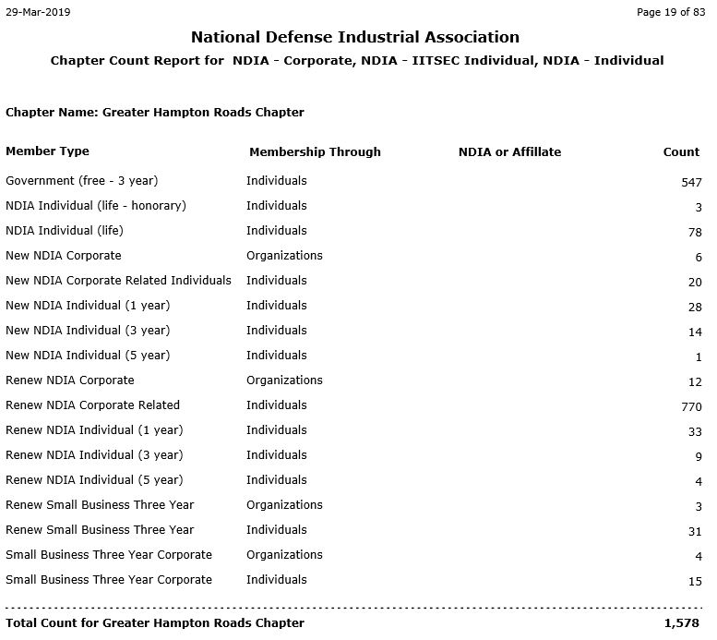
Report #1
Chapter Count
High level overview of demographics
i.e. 50% of members are free government members, 25% are corporate members, etc.
Present data at Board Meetings
Notes:
The first report is a High level overview of demographics in your chapter
This report provides high level information that can be used for your board meetings.
For example, “50 percent of our members are government, how can we strategize to recruit corporate members”

Slide 7
Report #2—Chapter Roster
Know corporate members in your chapter
Product Name=Membership Type
Refers to Chapter Count for breakdown of all membership types ie: Government, Individual, Corporate.
Title
Sponsorship opportunities
Notes:
MENTION “and this is just a SAMPLE roster; not actual data”
Product Name is the same as Membership Type ex: Govt, Individual, Corporate etc.
Title: You can get an idea of who you can reach out to for sponsorship opportunities.

Slide 8
Report #2—Chapter Roster
Know corporate members in your chapter
Customer Email/Email consent
Event email blasts, chapter updates
Join date
Uses: Personalized welcome letter, calls
Expire Date:
Uses: Reach out to members who have not yet renewed
Notes:
If the email consent column says no, exclude them from emails.
And speaking of emails, our team has created the Chapter Event Email Request form so that we can help promote your events/meetings.
Join date- You can see new members coming in and you can send a quick email welcoming them to your chapter or any sort of outreach and invite them to your upcoming events.
Expire Date- Outreach to those expiring and please feel free to send them our way and we will help the renew.

Slide 9
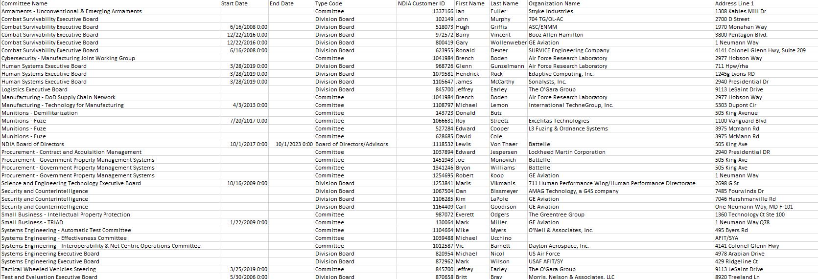
Report #3—Chapter-Division Collaboration
New quarterly report!
Know which Chapter members are Division leaders
Notes:
We heard you at the Leadership conference and wanted to provide a report that will strengthen the communication between chapters and Divisions!
Know which of your chapter members are involved in Division leadership
This reports includes people that have your chapter listed as secondary and tertiary. People can be a part of more than on e chapter.

Slide 10
Guest speakers

Slide 11
Central Florida Chapter

Slide 12
Member Engagement
Tiffany Sanders, President
Sean Osmond, Membership
23 APRIL 2019

Slide 13
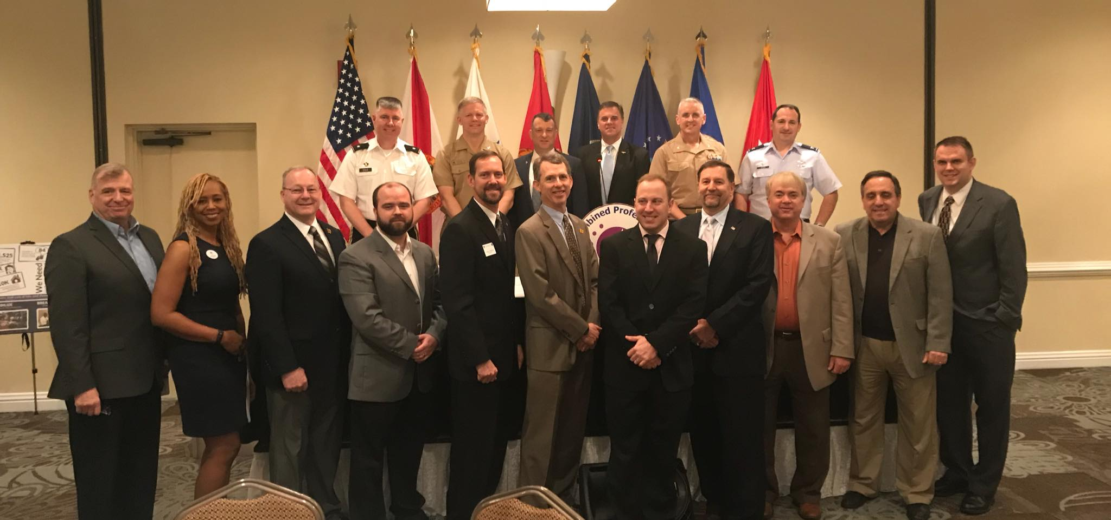
Membership Overview
Total Members
4602
Government
976
Industry
3557
Life
69

Slide 14
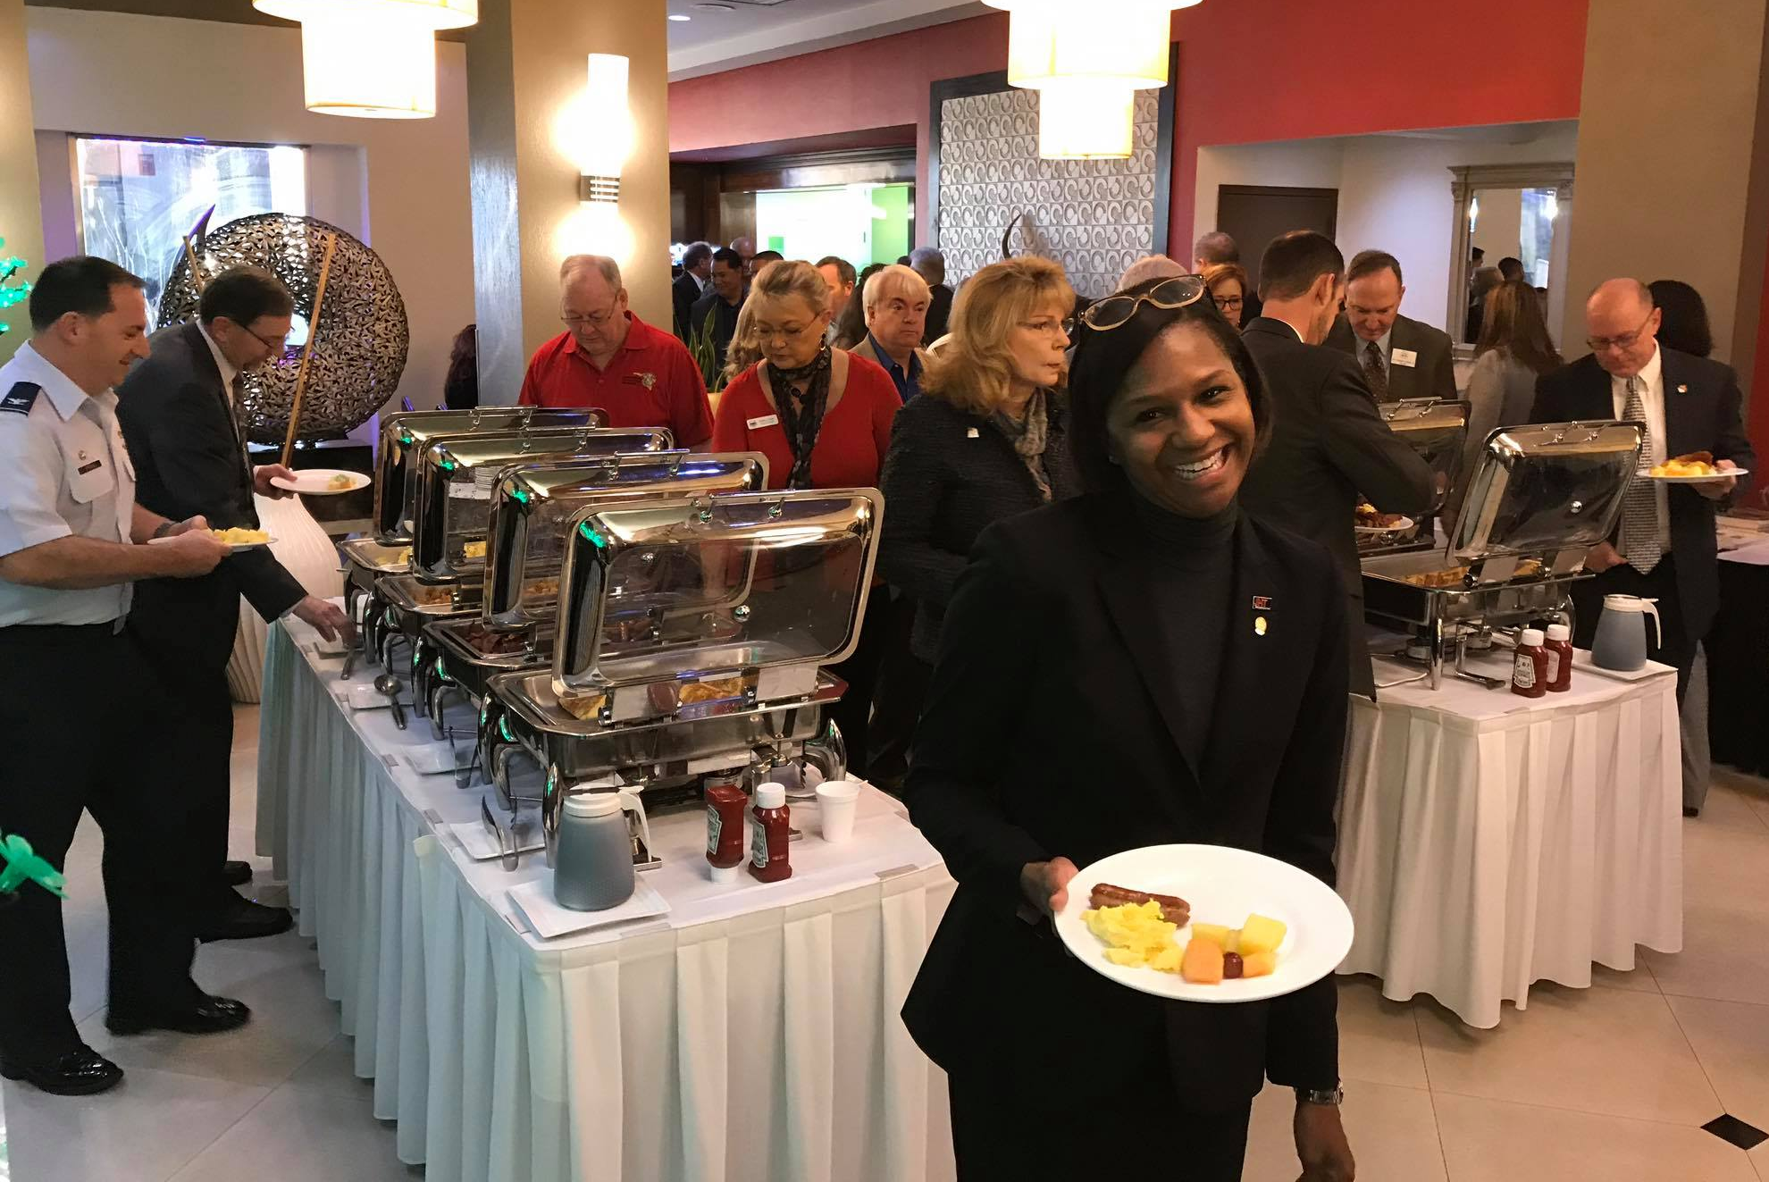
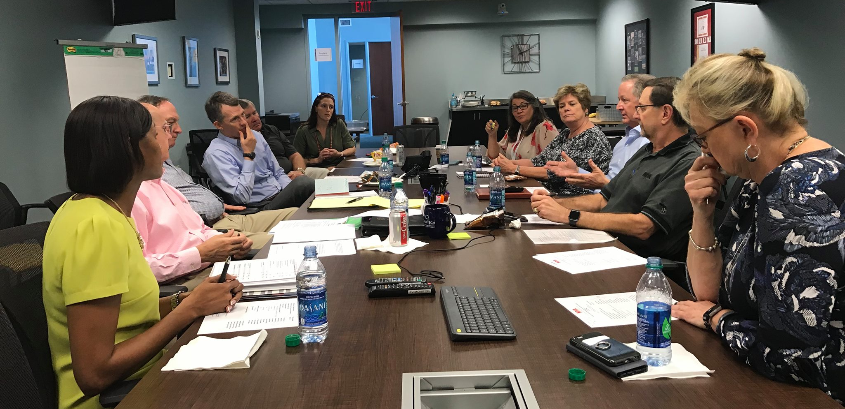
Segmentation and Outreach
Small, Medium, & Large Businesses
Government
Acquisition Corps
Elected Representatives
Combined Professional Association Group (CPAG)
Industry Days
Professional Development
RIDE
Industry Events
TSIS
Community Events
IITSEC Golf Tournament
STEM Workforce Programs

Slide 15
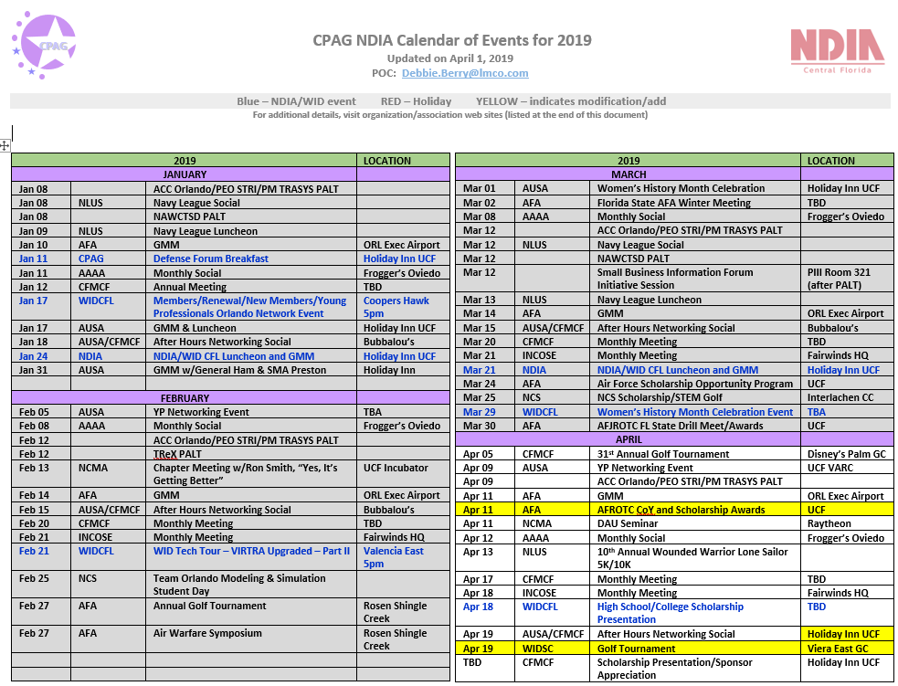
Email and Web Page Contact
Email updates
Direct Mail From Board
Notification of impending expiration
Updates from National
Event Calendar
List Cleansing
Web Page
General Chapter Info
Membership

Slide 16
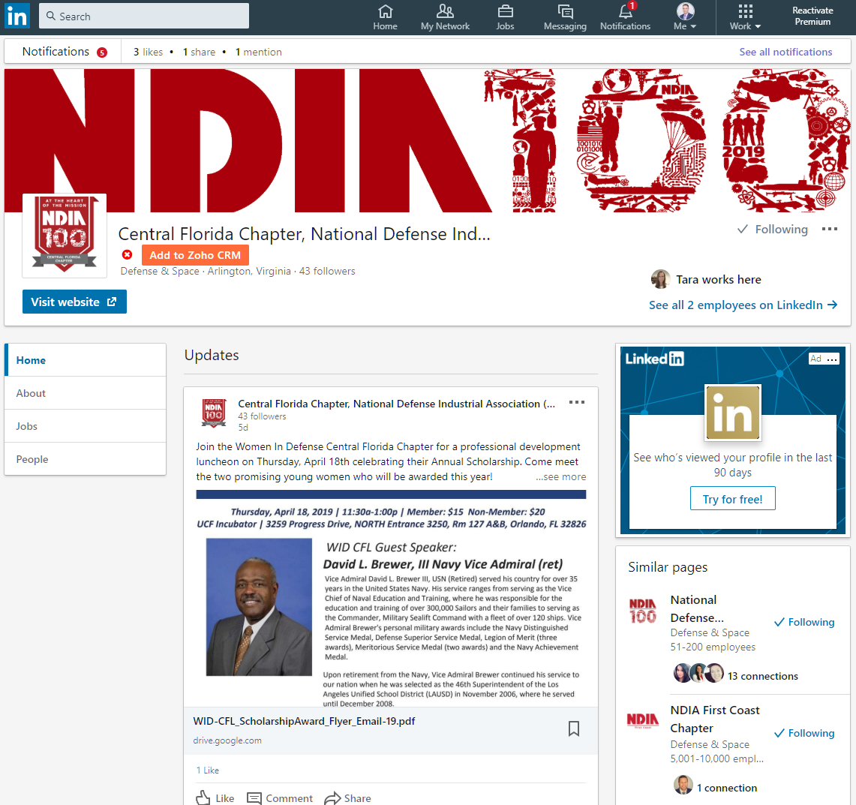
Social Media
LinkedIn
Facebook
Twitter
Instagram
Google
Zoho Social
Free Management Tool

Slide 17
Member Engagement
Tiffany Sanders, President
Sean Osmond, Membership
23 APRIL 2019

Slide 18
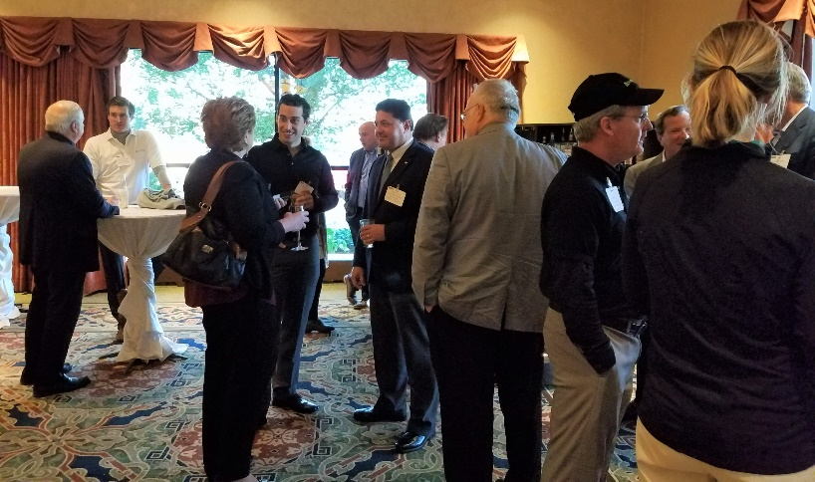
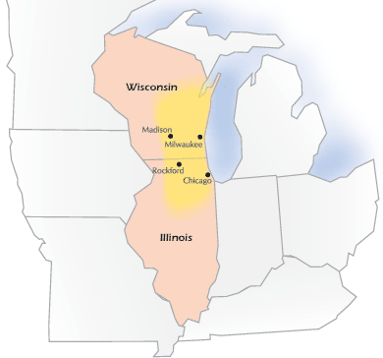
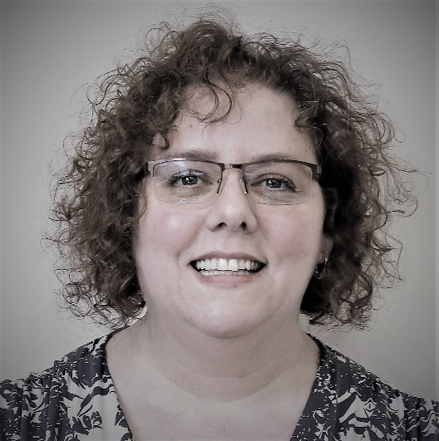
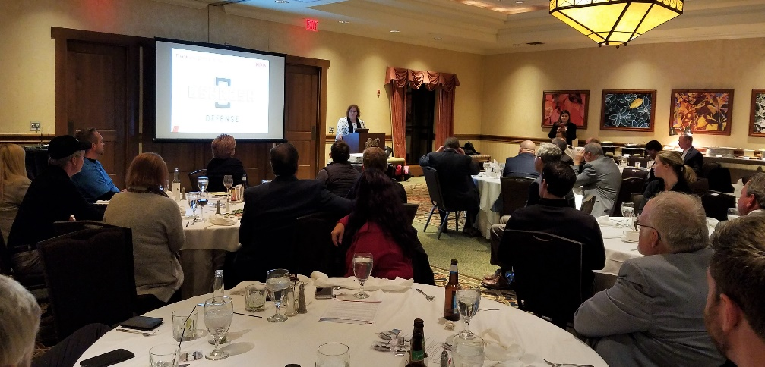
Great Lakes Chapter

Slide 19
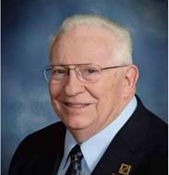
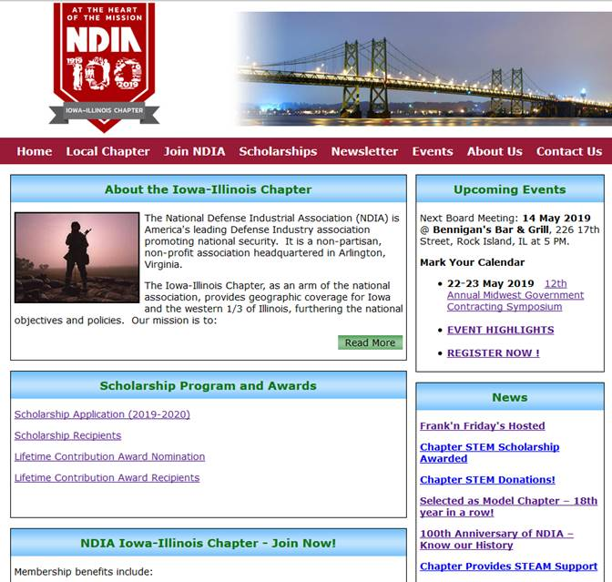
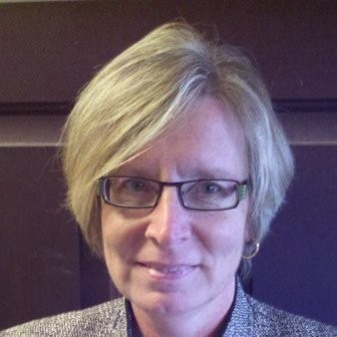
Iowa-Illinois Chapter

Slide 20
Questions?
Notes:
Thank you to our Chapter Leaders for sharing their knowledge. Now we will open up the webinar if anyone has any questions or additional examples of how their chapter utilizes their monthly reports.

Slide 21
Upcoming topics include:
Townhall with General Hawk
Policy Updates
Chapter Financials
Chapter Event Planning
…and more!

Slide 22
THANK YOU!
Were we not able to answer your question? Please email chapters@ndia.org

