Slide 1
Fall BoD Meeting
Integrated Precision Warfare
15 September 2023

Slide 2
Agenda – 15 September 2023 BoD Meeting
0900-0930 Intros, Baseline, Growth
Stick: BoD mtg objective; IPW vision, mission and value, events
Stick/Dan: Organization / membership / Hail and Farewell
Stick: Johnson Award Update
0930-1015 Strategic Context
Dan: Global Developments
Stick: PB24 Highlights
Joe: NDAA Developments
1015-1030 Social Media Training Refresher
1030-1115 Ms. Jennifer Boughton, Dep. DivChief, Joint Capability Division, JCS J8
1130-1200 Mr. Jim Ruocco, SES, Director, Air Platforms and Weapons, ASD(A)
1200-1230 Working Lunch: Plans for Air Armament Symposium (in lieu of PSTS 23)
1230-1345 IPT reports
1230-1255 Offensive IPT report
1255-1320 Defensive IPT report
1320-1345 All-Domain IPT report
1345-1355 Saved rounds
1355-1400 Final Points (Stick)

Slide 3
BoD Meeting Objective
Objective of the BoD meeting and briefs is to keep the BoD up to date on warfighting developments, so we can:
Consider how to modify/improve our programs to be relevant
Line up the most relevant speakers for our events
Articulate the value of our programs to potential attendees in current warfighting context
Ask good questions at our events
Others?

Slide 4
IPW Vision
IPW Division is the premier professional organization dedicated to advancing the art and science of integrated precision engagement concepts and technologies
Mission of National Security
Mutual Support
Mutual Respect
Camaraderie

Slide 5
IPW Mission
Integrated Precision Warfare (IPW) Division’s primary mission is to advance offensive, defensive and network integrated precision engagement concepts and technologies.
To facilitate this mission, IPW provides an ethical environment for government, industry, and academic leaders to:
Communicate and collaborate on solving critical issues facing the warfighter today and in the future
Discuss and expound upon on national defense policy and military strategy
Rationalize required military capabilities with the broad range of available technology and systems
Advocate for investment in critical science and technology areas to further the effectiveness of integrated precision engagement operations

Slide 6
IPW Value
IPW facilitates classified dialogue from the strategic to operational to tactical and technical levels between industry, academia and government organizations regarding our Nation’s strategic competition.
IPW builds on the success of the former Precision Strike Association (PSA) and Strike Air Land Attack Air Defense (SLAAD) Division
IPW brings military, government, industry and academia to a common forum to solve issues across joint, multi-domain kill chains in the era of great power competition
IPW provides collaborative classified venues to critically consider enabling concepts and technologies supporting the integration of force across the offensive and defensive spectrums of warfare via both kinetic and non-kinetic means
IPW is proud to continue marquee programs including the Annual Review, the Technology Symposium, Executive Roundtable Sessions and Command Visits

Slide 7
Integrated Precision Warfare Division Organization
Integrated Precision Warfare
Chairman
Converse
Vice Chair
Shaffer
EXCOM
Advisory
Council
Typically retired mil/GS
SLAAD Chairman
Emeritus
Smith
IPW Chairman
Emeritus
Masson
Senior SMEs
Secretary
Sordyl
External Liaisons
Comms
Braun
NDIA
Support Team
Navy
Air Force
Army
Marine Corps
MDA
OSD
JCS
Space
Offense
Wilcox / DeMaso
Defense
Glebocki / Syring
Joint All-Domain Operations
Klunder / Romani / Stader
Policy
Vacant
Membership
vacant
Awards
Cummins
Small Business
TBD
Programs
Neace / Kovach /
Chankaya
Strike
Uzzell
Air Defense
C2/BM
C4ISRT
IPWR
PSTS
Air Dominance
Kindley
Missile Defense
Liaison
Non-Kinetic
EMW/Cyber
Industry
Roundtables
Service Command Visits
Counter Hypersonics
Service & Agency
Liaisons (Mil/GS)
Organizational Liaisons
Think Tanks
Industry
Academia
National Labs
FFRDCs / UARCs
Members of these orgs who are our liaisons to their org (formerly Board of Directors)
Notes:
Functions:
EXCOM -
Service/Agency Liaisons – same as below for the Orgs
Organizational Liaisons (formerly Board of Directors) – members of these orgs today – they help us get speakers in the orgs –they help us get members to be active in our IPTs - they help spread the word re our events inside their org – and they ensure we are appropriately properly covering the equities of that org- expected to be active participants in Division function
Advisory Council:
Typically retired mil/GS
Examples:
ADM Swift
RADM Manazir

Slide 8
2023 Hails / farewells
Hail
Tate Westbrook
Seth Shipley
Leah Martinez
Sean McDonald
Farewell
Charlie McCullough

Slide 9
Perry Award and Johnson Trophy

Slide 10
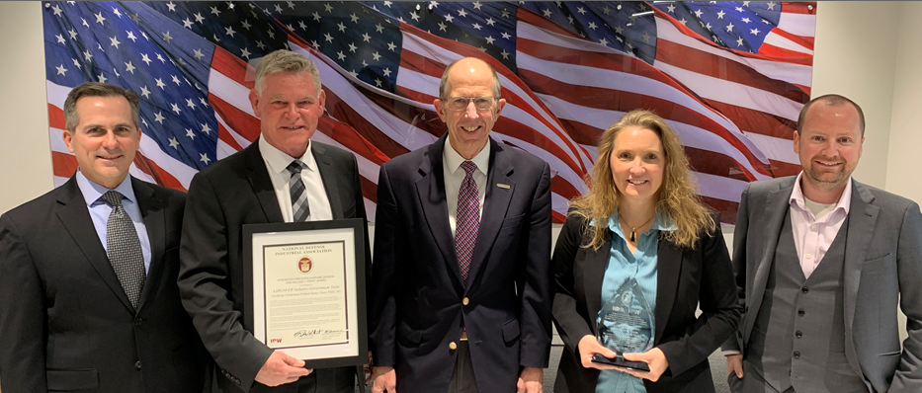
Perry Award Summary 2023
Five outstanding Nominations received
Perry Award Jury reviewed all of the nominations and selected the 2023 Perry Award Winner
AARGM-ER Industry / Government Team
Award presented at the Spring 2023 IPWR

Slide 11
Richard H. Johnson Award Criteria
The award honors notable technical innovations in the field of integrated precision warfare which advanced the defense of the United States.
Recipients made these contributions as individual technologists, advancing state of the art.
Nominees are sought whose accomplishments and contributions:
Transcend a single program
Were sustained over a long period of time
Have been widely felt by the warfighters who defend the United States
Have influenced other technologists
Have made precision strike systems more available to warfighters

Slide 12
Johnson Trophy Process Overview 2023
Solicit Nominees from Johnson Jury
Process Definition
Aug - Sept 2023
29 September is the deadline for submissions
Jury Selection of Winner
Jury Definition – prior Johnson Trophy Winners
Timeframe and Process
Solicit Nominees from Industry via Website
Oct NLT 13, 2023 - final selection
Collect Data for Award
Aug - Sept 2023
In parallel to Jury Nominations
29 September is the deadline for submissions
Johnson Trophy Award Presentation
Citation and Award Production
Winner is Notified
Award Presentation Nov 7-8
9th Air Armament Symposium – Fort Walton Beach, Fla.
Oct 2023
Oct NLT 20, 2023
Secure Funding

Slide 13
2023 Richard H. Johnson Award Update
IPW Lead: Laurie Cummins
Nominations close on 29 September (1 nom to date)
ndia.org/divisions/integrated-precision-warfare
Jury is ready – selection NLT 13 October
Winner will be notified – with invite to attend
Letter from HON Norquist
BIO w/photo
Engraving and citation
Slides for presentation at Air Armament Symposium

Slide 14
Strategic context trends / hot topics

Slide 15
Trends / Hot topics (1 of 2)
Mergers / Acquisitions
BAE / Ball
L3 / Aerojet Rocketdyne
International Developments
Russia: War Crimes, Playing ‘chicken’ ...
China: “...more thunder, less rain”; Philippines
Iran: Drones, Speedboats
Ukraine: anti-drone trucks
N. Korea: weapons to Putin
Innovation
NATO Innovation Fund / DIANA
Office of Strategic Capital
Space
LM, NG satellites for JADC2: now CJADC2. C is for “Combined”
Hypersonics
DMS / Obsolescence management
Joint Naval drills ... again

Slide 16
Trends / Hot topics (2 of 2)
Artificial Intelligence
Generative AI / Task Force LIMA ... Perception shaping / ‘synthetic information
Data
Software: “... a hard business ...”
How much is too much ...?
Cyber
Civilian Vacancies: DoD Cyber Workforce Strategy
Unmanned systems
Drone Warfare: “Replicator” ... Norquist positive comment
Collaborative Combat Aircraft - AI testing, prototype airframes, trust
TF 59, Ukraine (... a DREADNAUGHT moment?)
Tuberville Impact
Service Chiefs
Senior Officials
Family moves
Affordable Mass
USAF mid-range PGMs ... Mitchell Institute
Bio fuels / Electric Vehicles

Slide 17
Strategic context PB24 Highlights

Slide 18
DOD TOP LINE FY24 PB
DoD Total
($B) | FY23En | FY24PB | % Change
MILPERS | 172.2 | 178.9 | 3.9%
O&M | 319.9 | 329.7 | 3.1%
Proc | 163.7 | 170.0 | 3.8%
RDTE | 139.4 | 145.0 | 4.0%
Revolving | 1.7 | 1.7 | 0.0%
MILCON | 19.0 | 16.7 | -12.1%
Total | 815.9 | 842.0 | 3.2%
INTEGRATED DETERRENCE
Air Power, Naval Power, and Land Power: $170B
Nuclear Enterprise and Missile Defeat and Defense: $68B
Long Range Fires: $11B
Space and Space-Based Systems: $33B
Cyberspace Activities: $13B
Resource Allocation by Service
FY22 to FY24
CAMPAIGNING
BUILDING ENDURING ADVANTAGES
$B | FY22 | FY24 | Change FY22 to FY24
Army | 24.3% | 22.0% | -2.3%
DoNavy | 29.8% | 30.4% | 0.6%
DoAF | 29.8% | 30.8% | 1.0%
Def Wide | 16.1% | 16.8% | 0.7%
Readiness: $146B
Indo-Pacific and Europe: $14B
Taking Care of People: 5.2% pay raise for military and civilian
Innovation and Modernization: $145B
Largest change from FY23 to FY24 was minus 0.7% Army

Slide 19
HAC & SAC Defense Marks FY24
Note 1:
House mark traded decrease in procurement (-$4B) for increase in O&M (+$3B)
Title | PB Request ($B) | HAC Mark delta ($B) | SAC Mark delta ($B)
MILPER | 178.9 | -1.0 | -2.4
O&M | 290.1 | 3.0 | -0.2
Procurement | 169.1 | -4.0 | 0.3
RDT&E | 144.9 | 2.0 | -1.5
Revolving | 1.7 | 0.0 | 0.1
Other DoD | 40.9 | 1.2 | 0.8
Related Agencies | 1.2 | 0.0 | -0.1
General Provisions | 0 | -0.9 | 8.0
Total | 826.7 | 0.2 | 4.9
Note 2:
Neither bill provides additional funding for Ukraine
The Administration has requested additional funding for Ukraine and other ‘critical needs’ via a Supplemental
$8B | Emergency Appropriations
$2B | Unfunded Requirements COCOMS and Services
$1.9B | Military Readiness
$1.5B | Increased Acquisition Cost
$1.1B | PDA for Taiwan
$1B | DIB Shortfalls
$.5B | Fuel Shortfalls
Note 3:
SAC total exceeds the Fiscal Responsibility Act (FRA) of 2023 cap by $4.9B
However, $8B is labeled as “Emergency Appropriations”
Unclear if House will support

Slide 20
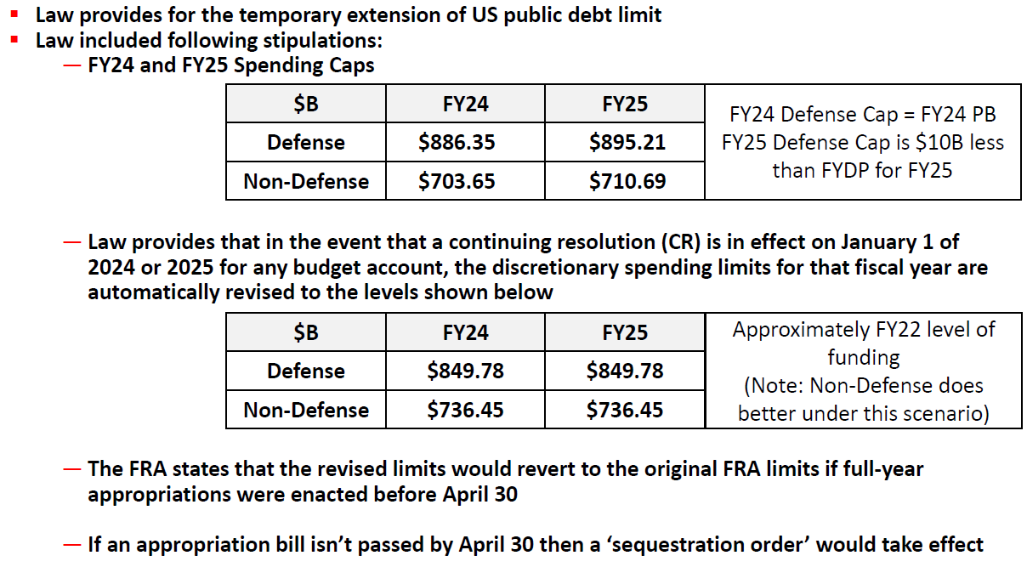
Fiscal Responsibility Act of 2023 signed into law on 3 Jun 23
FRA will cause unique challenges that will begin on 1 Jan ‘24 if we are still operating under a Continuing Resolution (CR)
It also imposes additional challenges if we are still under a CR on 30 April ‘24
Note: Defense Cap includes ~$60B DoE nuclear weapons budget

Slide 21
FY24 Appropriations Path Ahead
Administration requested Supplemental Funding on 10 Aug ‘23
Requested ~$40B to include in FY24 Continuing Resolution
‘Three sets of critical needs’
Ukraine and other international needs
US disaster relief needs
Border and migration needs
No Congressional action on it yet
Unclear how House & Senate will handle it with respect to Fiscal Responsibility Act
Very few legislative days left in FY23
Significant differences between HAC and SAC
House unlikely to agree to Senate’s total above the Fiscal Responsibility Act
House traded decrease in procurement (-$4B) for increase in O&M (+$3B)
TBD if House will support the $8B ‘Emergency Appropriations’ in Senate bill
If House supports it, a significant portion of their O&M increase is included
Near zero probability of an FY24 Appropriations Act before 30 Sep
Expect a Continuing Resolution or perhaps a brief Govt Shutdown

Slide 22
FY24 NDAA
Passed on House floor 7/14 (219-210)
Passed on Senate floor 7/28 (86-11)
Reports and Language of Interest to IPW
Senate
Extends waivers for the streamlined acquisition of defense stocks related to Ukraine and authorizes additional munitions eligible for multiyear procurement contracts
Supports the use of multiyear contracting authority as a tool to improve industrial base stability.
Directs a review and assessment of Army air and missile defense modernization activities
Directs a review and assessment of the Army’s long-range fires modernization efforts and plans.
House
Requires DoD to develop new additional aerial testing corridors to address shortfalls in hypersonic testing capacity
Provides multi-year procurement authority for several munitions critical to conflict in the Indo-Pacific
Requires DoD to report to Congress on foreign control and influence over the supply chain for critical minerals, metals, supplies, services, and materials used for defense technologies.
Requires an assessment of foreign control and influence over the supply chain for critical minerals and metals used for defense technologies.

Slide 23
Social media training refresher – Jeff Braun

Slide 24
Ms. Jennifer Boughton Dep. Div Chief, Joint Capability Division, JCS J8

Slide 25
Mr. Jim Ruocco, SES Director, Air Platforms and Weapons, ASD(A)

Slide 26
Working lunch

Slide 27
2023 Air Armament Symposium Dominant Air Armaments to Deter, Fight, and Win
7-8 November 2023
DESTIN-FT WALTON BEACH CONVENTION CENTER FT WALTON BEACH, FL
Day 2 afternoon: classified outbrief of govt WEPCON
Register at: ndiaaas.com
IPW is assisting with these panels:
IPW Joint PEO Panel
Weapons Requirements Panel
Future Weapons Tech Panel
Government Test Panel
IPW Weapons Kill Chain Panel
Fees
NDIA member in person prior to 7 Oct: $375, thereafter $425
NDIA member virtual, UNCLAS only: $245
DoD Civilians and Active Duty Military: no cost
Wednesday evening social at Air Armament Museum: $20

Slide 28
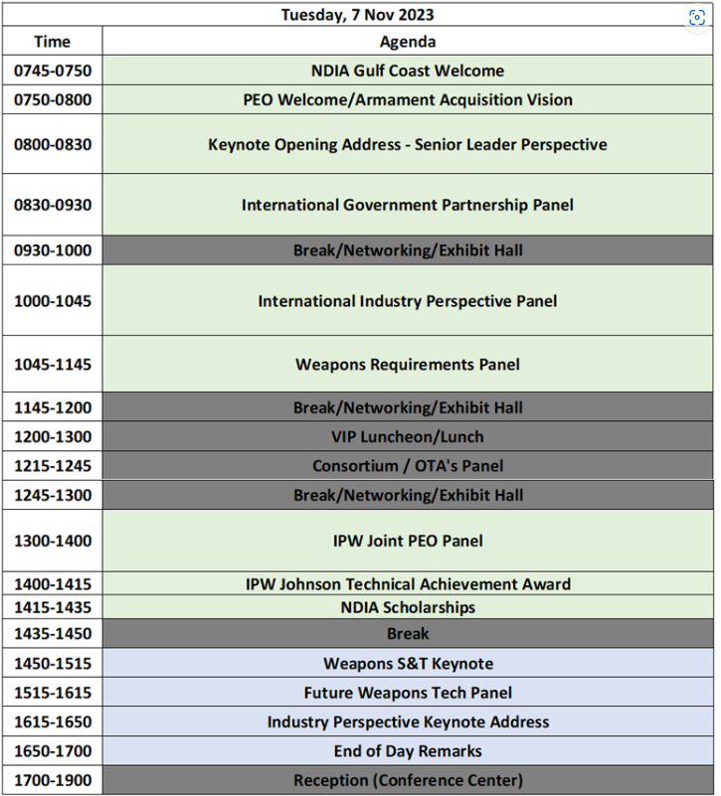
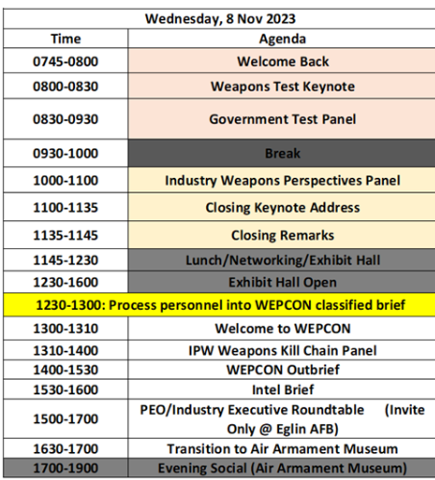
2023 Air Armament Symposium - agenda

Slide 29
IPT Briefs

Slide 30
Defense IPT Report
Joe Glebocki
Bob Syring
September 2023

Slide 31
Army Air and Missile Defense Initiatives
Overarching vision for the Army AMD force through four lines of effort:
LOE 1- Develop air and missile defense capabilities:
Integrated Air and Missile Defense Battle Command System (IBCS)
Lower Tier Air and Missile Defense Sensor (LTAMDS)
Maneuver Short Range Air Defense (M-SHORAD
Integrated Fire Protection Capability (IFPC)
LOE 2- Build AMD capacity for Multi-Domain Operations – Invest in Personnel and Increased Force Structure
LOE 3- Provide trained and ready air and missile defense forces – Institutional, Operational and Self-Development training programs
LOE 4- Maintain forward presence and build partner capacity - continued cooperation toward interoperability with Allies and Partners

Slide 32
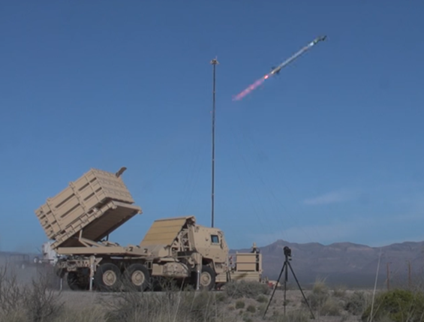
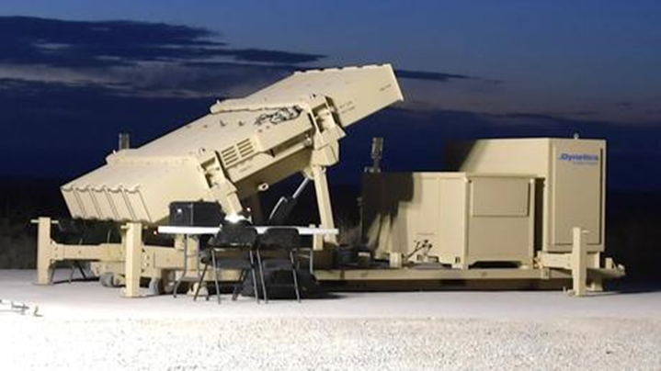
Indirect Fires Protection Capability (IFPC Inc.2)
U.S. Army is developing launcher system prototypes for its enduring system to counter drone and cruise missile threats
Army has successfully demonstrated launcher integration to the Army’s Integrated Battle Command System (IBCS) in Gov’t Lab
Army expects to receive first prototype launchers in Q4 FY23. Field 16 prototypes and 60 interceptor prototypes missiles in 2024.
IFPC Inc. 2 System: Launcher, Sentinel Radar, IBCS, AIM-9X interceptors
In January 2023 – Army is investigating new interceptor v. supersonic cruise missiles and large caliber rockets
Army may initiate a follow-on production contract for 400 launchers and associated interceptors

Slide 33
DE – Service Programs and Technologies
Navy
HELIOS (60kw – 150kw):
CUAS, small boats, c-ISR threats, BDA
Testing on DDG-51 Flt IIA Class
HELCAP (300kw+)
Counter cruise missile (CM), air threats
Laser Layered Defense (LLD)
Army
DE M-SHORAD
50kw, Stryker Mounted, counter drone, rockets
IFPC - HEL
300kw, Vehicle TBD, counter air, CM
IFPC – HPM
C-UAS focus combined with HEL
Air Force
CHIMERA
Long range HPM, Counter UAS
THOR
HPM short-range air base defense
HELWS – Mobile Laser, C-UAS, vehicle mounted

Slide 34
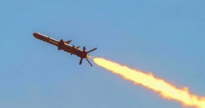
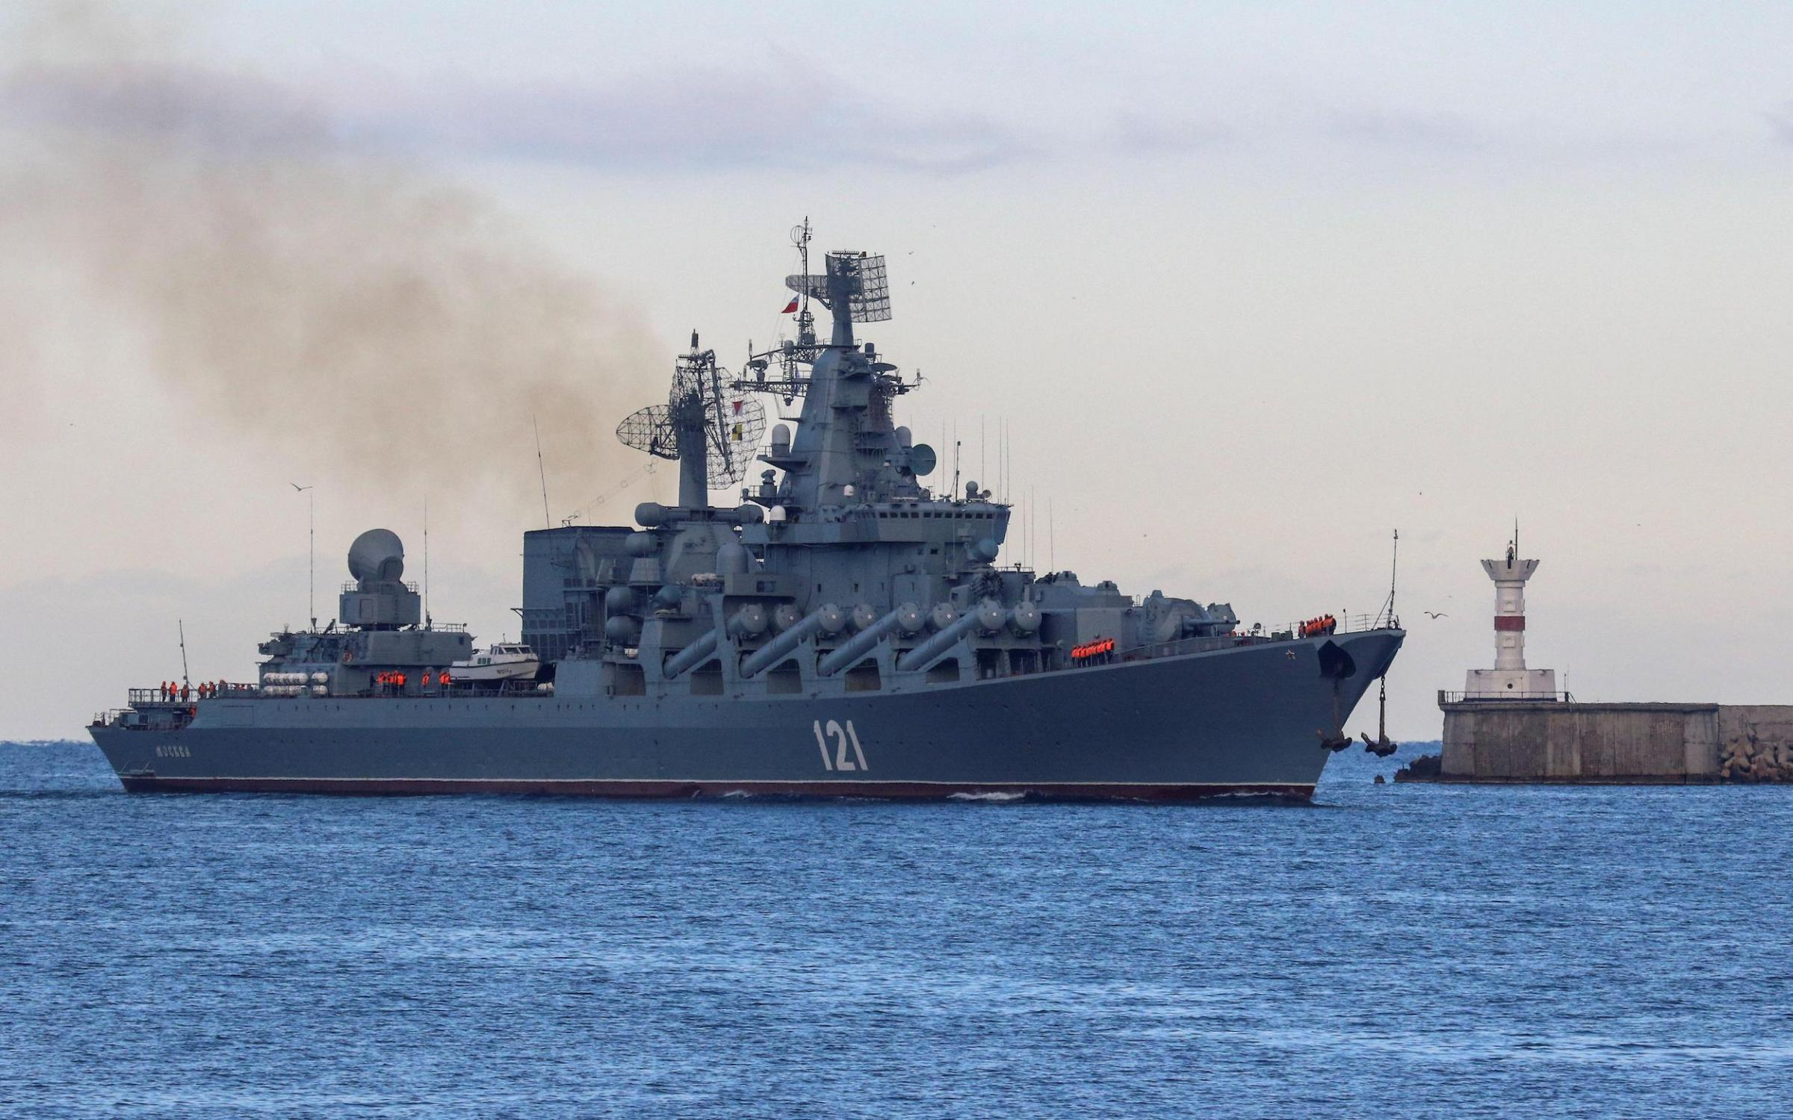
Navy – Land Based ASCM Threats and Defenses
Sea Control/Denial from Land Based Cruise Missiles driving Ship Self Defense calculations
Ukrainian sinking of Moskva – sunk by low-cost, short-range Neptune missile
Pacing Threat missiles - much longer range
Contributes to A2/AD bubble for Sea Control
Trends in Cruise Missile threat defense:
Smaller signatures and lower/higher altitudes.
Higher speeds and high-acceleration maneuvers – including Hypersonic missiles
Radiation control and multimode guidance.
Advanced electronic countermeasures.
Hardening and relocation of vulnerable components.
Coordinated arrival times.
USN Potential Counter Measures
Longer range radar systems (SPY6) with upgraded IAMD
OTH targeting, Cooperative Engagement, Larger missile magazines with USVs
Smaller, more distributed operations
Submarine/Air launched missiles creates space for surfaces forces to operate

Slide 35
Air Force AMD
Agile Combat Employment (ACE)
AF Doctrine Note released August ‘22
Five core elements:
Posture, C2, Movement and Maneuver, Protection, and Sustainment.
Dis-aggregated Basing concept
Hub-and-Spoke Model with large and many smaller more mobile bases
“Defensive Counter Air (DCA) is paramount to protect the force from …threats, including sUAS, cruise missiles, ballistic missiles, and hypersonic weapons”.
Forces less easily targetable because of their disbursement
CSAF released new doctrine/memo on Mission Command and application to ACE, Aug 2023
Operational Imperative 5 (OI 5)
Part of SECAF Outline Focus on China
7 Initiatives
OI 5: Defining optimized resilient basing, sustainment, and communications in a contested environment
Formulated in the FY24 POM cycle

Slide 36
Defense of Guam
MDA FY24 budget request includes $800M+ to develop and begin constructing its architecture to defend Guam against a range of threats including ballistic, cruise and hypersonic missiles
Army was designated as the acquisition lead for the defense of Guam, June 2023
The service requested an additional $638 million in FY24 including:
3 Lower Tier Air and Missile Defense Sensors;
Patriot missile defense systems;
Mid-Range Capability missile launchers;
Indirect Fires Protection Capability launchers; and
Integrated Battle Command System
MDA planning first flight test of some elements that will make up the air and missile defense architecture of Guam in Dec 2024
The test will involve the Navy’s Aegis weapon system deployed to Guam and the SM-3 Block IIA interceptor

Slide 37
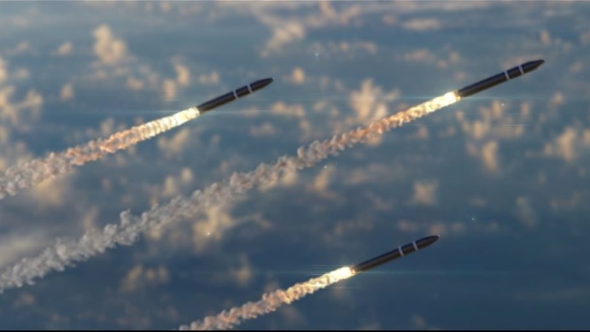
Next Gen Interceptor (NGI)
MDA awarded development contracts to two teams — Northrop Grumman, partnered with Raytheon, and Lockheed Martin, partnered with Aerojet Rocketdyne — in 2021
Development (FY21-27): 10 NGI test systems
Production (FY26-30+): Up to 100+ NGIs
The goal is to field the new interceptor by 2028
A 2021 independent analysis from the CAPE found NGI’s development price tag could total $13B
Procurement and O&S could be $2B+
Former MDA Director, VADM Hill, wanted to do a “fly before you buy” approach before down selecting to a single system
GBI EKV SLEP is also ingoing to upgrade the current fleet

Slide 38
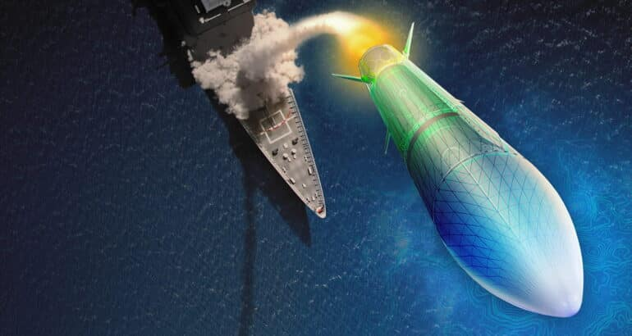
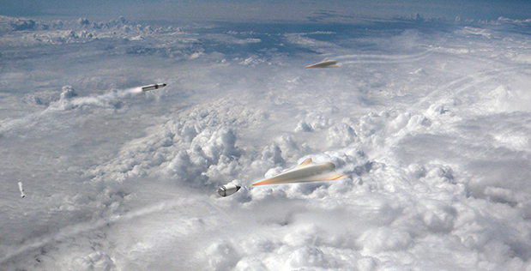
Hypersonic Defense
MDA funding for GPI
$292M FY23 UPL plus up awarded ($517M total)
$209M FY24 budget request
Program Status
In early 2021, MDA initially chose three contractors to compete on the design
In June 2022, MDA narrowed it down to two companies, Northrop Grumman and Raytheon
PDR delayed to 4Q 2026 due to funding reduction
Japan's MoD announced they will work with U.S. on joint development
MDA Exec Dir stated last month that program is “throttled” due to new technology that has to be matured, but hopes to ultimately accelerate the schedule
During FY24 posture hearings, VADM Hill said he supports the first GPI deployment in the early 2030s
House version of the FY24 NDAA includes a provision requiring MDA to reach IOC by the end of 2029 with 12 interceptors fielded
DARPA also continues working on Glide Breaker
Began in 2018 to develop and demonstrate technologies to enable defense against hypersonic systems

Slide 39
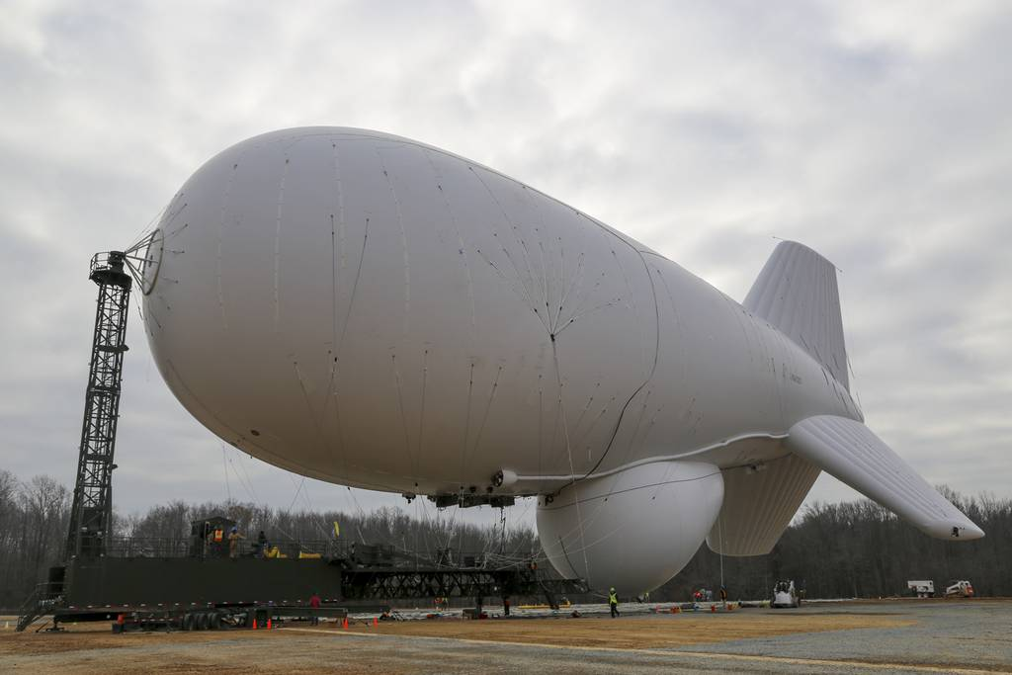
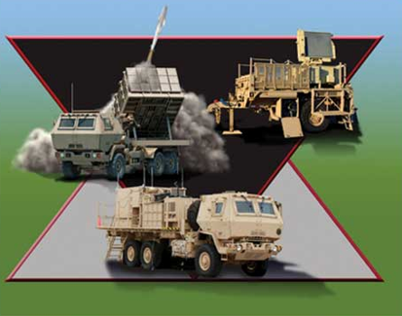
Cruise Missile Defense-Homeland
DEPSECDEF Hicks assigned USAF lead responsibility for homeland defense against cruise missiles, Aug 2022
Responsible to build the architecture and manage the program moving forward
Mission: Defeat cruise missile threats from Air and Sea-based assets
USD(A&S) is overarching acquisition lead
Conducted an Integrated Acquisition Portfolio Review (IAPR) to survey both current and planned investments across the U.S. military to determine potentially relevant programs that could be leveraged
Army owns mission for AMD of forward deployed bases
FY21 NDAA directed the Army and AF to jointly develop a strategy for defense of air bases and prepositioned sites OCONUS against emerging missile threats,
USAF began an Air & Cruise Missile Defense of the Homeland AoA, Jul 23
Produce recommendations next spring for investments -- with implications for Army, Navy and Missile Defense Agency spending plans -- in the FY26 budget
November 2022 unclassified summary of that Defense Science Board study recommended “an adaptable, scalable and affordable framework for homeland air defense that incorporates emerging technological innovations to ensure all-domain awareness, assured tracking, secure command and control and affordable engagement”
NORTHCOM/NORAD leaders have been vocal about the need to move past the focus on the kinetic endgame
Looking beyond radar, command and control capabilities paired with guided missile interceptors packaged to shoot down a cruise missile -- and think more broadly about long-range detection, resilience, redundancy, hardening and strategic messaging.
NORTHCOM developing plan to defend critical infrastructure
Point defenses but expanding to other efforts-EW, deception, UAS, etc.
Costs have been estimated at $32B-$466B

Slide 40
Expanding Homeland Defense?
MDA Exec Dir DeSimone revealed that USD(P) has tasked the agency to consider options for defending against a wider set of nations
“The Department has asked us to think about threats -- ballistic threats, maneuvering threats, hypersonic threats -- from a regional construct from any source”
2022 MDR reiterated a long-standing policy that the United States will rely on strategic deterrence against China/Russia ICBMs
HASC advanced its version of the FY24 NDAA with a provision that would change the policy
White House states this is destabilizing, unaffordable and undoable
SASC FY24 NDAA mark includes a provision that affirms the current policy
Lt Gen Guillot nominated to be the next dual-hatted chief of NORTHCOM and NORAD
During SASC confirmation hearing in Jul 23, he said he supports the current policy to limit homeland defense to rogue threats, but he believes change could be warranted

Slide 41
Offensive IPT Report 15 September 2023
Bill ‘BC’ DeMaso, Chair
David ‘Uz’ Uzzell, Air Dominance
Jeff ‘Leno’ Kindley, Strike
Objective of this report is to keep the IPW informed of current USG priorities in the offensive domain concepts and technologies

Slide 42
Offensive Strike Warfare
Services continue long range, high speed / hypersonic capability development
Counter-Maritime Capabilities growing
Long Range Fires & Loitering Munitions high priority
Redundant Long Range Kill Chains
OTH capabilities for Counter-Air & Counter-Maritime
Need for Long Range Air-to-Air to counter ‘red’ OCA/DCA investment
Operational Imperatives – Industrial Base strengthening
Collaborative Combat Aircraft (CCA) budget growth
COE’s – Weapons / Test & Training
Hypersonic / High Speed Weapons
Multi-Domain Operations – JADC²
Offensive Anti-Surface Warfare
Long Range Superiority
Future Strike Attributes

Slide 43
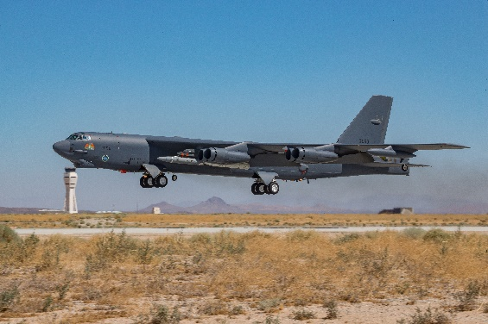
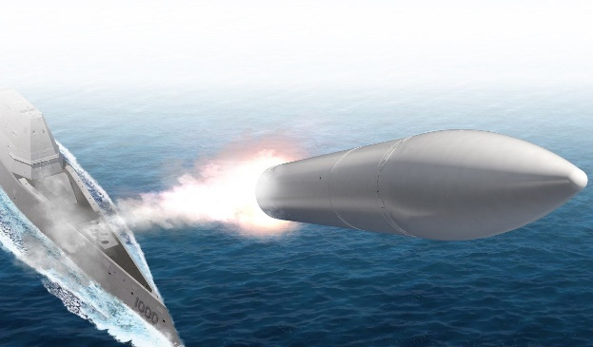
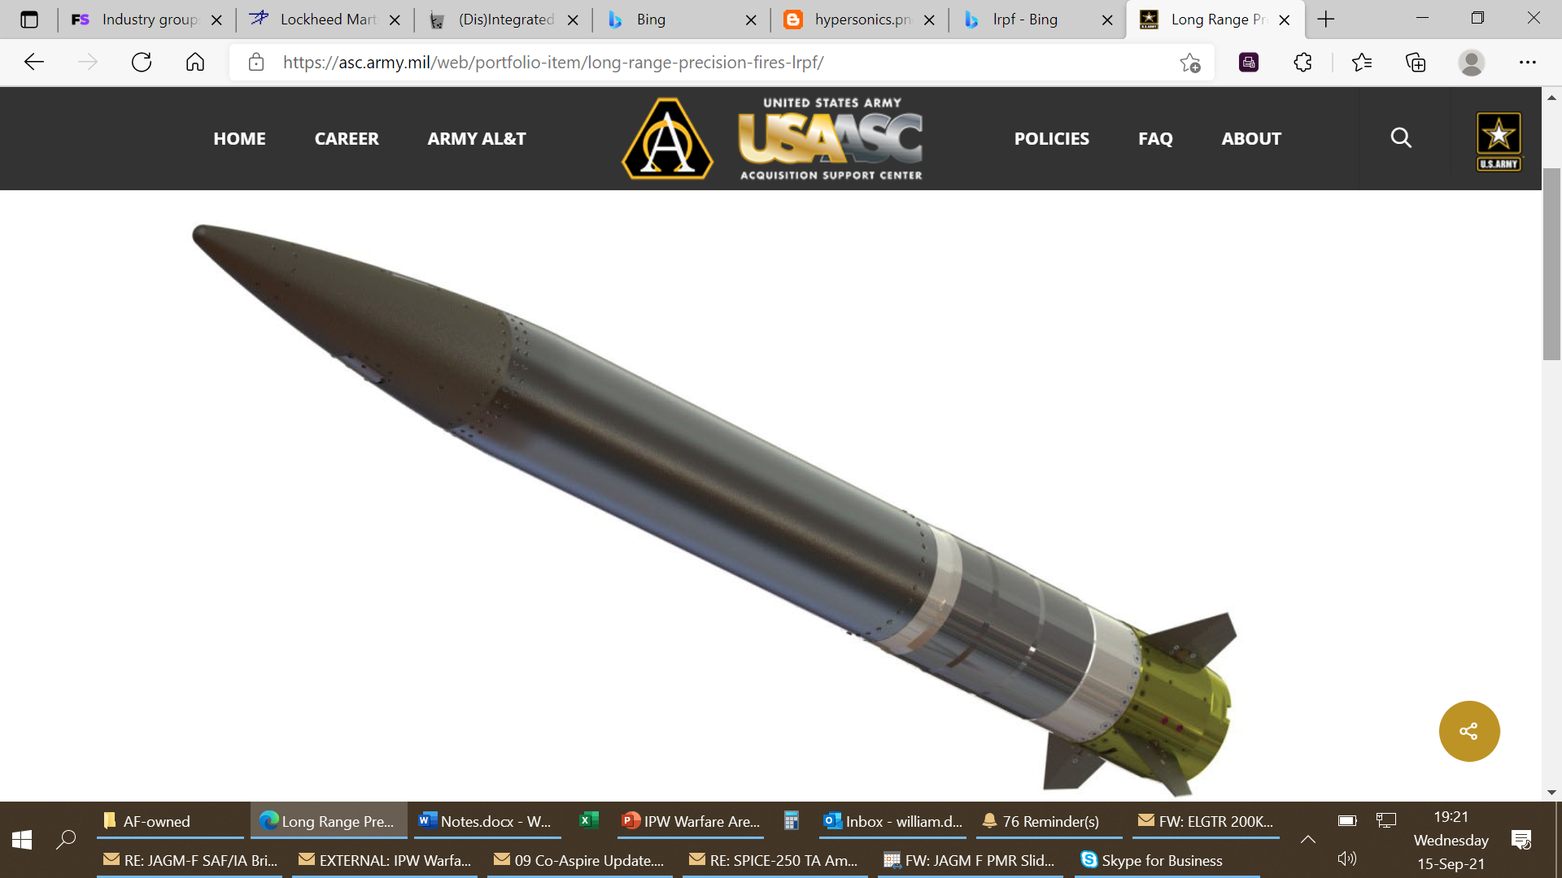
Hypersonic / High Speed Weapons Responsive Strike Capabilities
Army – Long Rng Hypersonic Wpn (LRHW)
Army/MC – Long Rng Prec Fires (LRPF)
ER-GMLRS
PRSM
DARPA – OpFires, HAWC & TBGW
Navy – CPS, HALO
AF – ARRW & HACM
AF/Navy – SEAD/DEAD
“Navy contracted to develop a hypersonic anti-ship missile. The Hypersonic Air Launched Offensive Anti-Surface (HALO) will be fielded over the next decade, allowing the navy to operate in contested battle space and anti-access/area denial environments.”

Slide 44
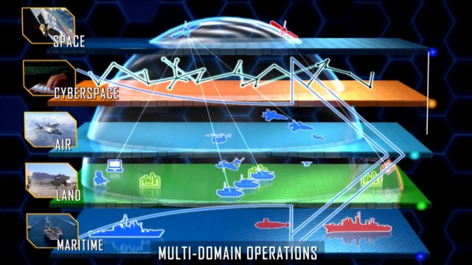
Multi-Domain Operations Joint All Domain Command & Control (JADC²)
Integrated, Multi-Domain Cross-Service Kill Chains
Need Integrated Targeting Cells
Autonomous Collaborative Platforms
Layer in Machine Learning, Artificial Intelligence and Predictive Analytics
Need Missile Defense in Layered Defeat for Distributed Basing Concepts
Expand AI to Enable OODA

Slide 45
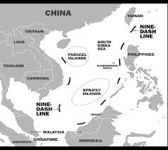
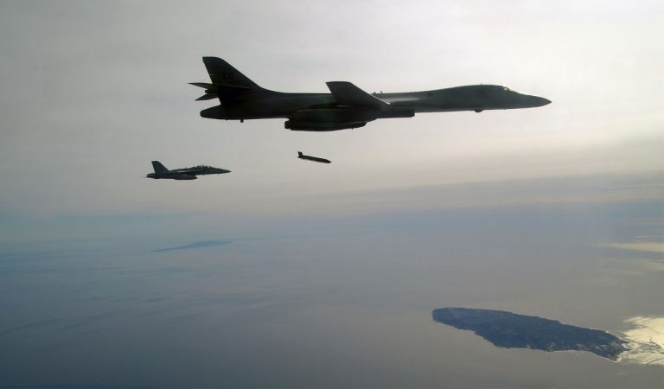
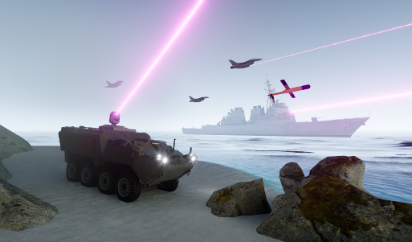
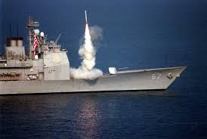
Offensive Anti-Surface Warfare Counter Maritime Ops
Threat to freedom of navigation / commerce
Capability to engage land / sea targets
Counter Red SAGs and Armada of Amphibious Landing Craft
Joint / Coalition Modeling Simulation & Analysis
AF Mission Prioritization -- Maritime

Slide 46
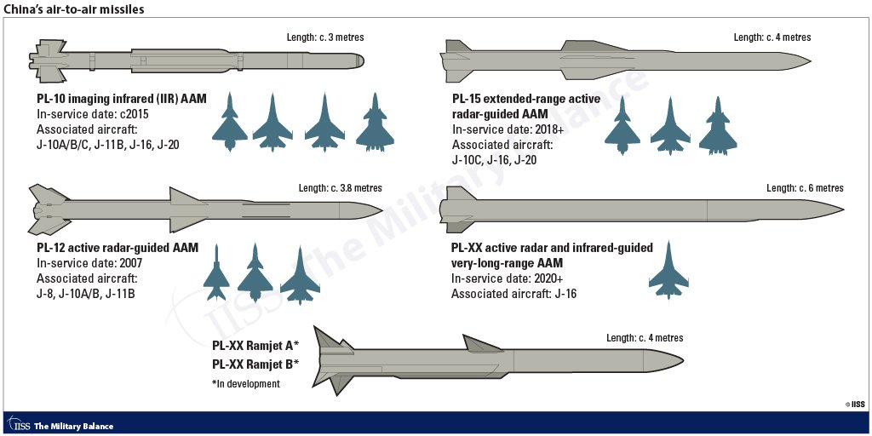
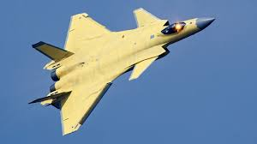
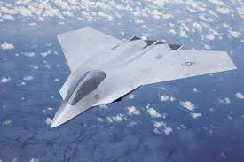
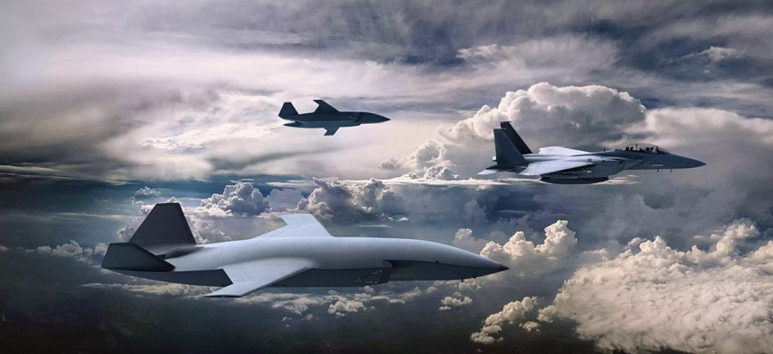
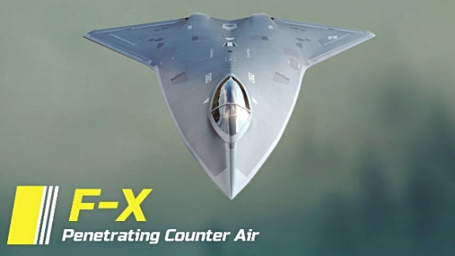
Long Range Superiority OCA & DCA
Quick Response to Red Air Missile Kinematics
Improved / Longer Range Weapon Quality Track Files
Investing to Counter Adversary Gains -- USAF & USN NGAD
CCA in Budget
Munitions Crosscutting Operational Enabler (COE) – affordable mass/munitions

Slide 47
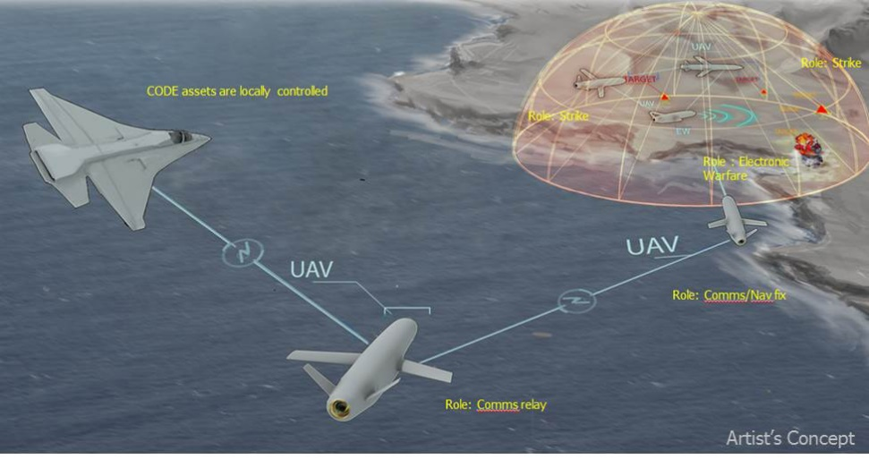
Future Strike Attributes
Capabilities
Speed / Range / Signature
Maneuverability / EA
Precision / Discrimination
Stand In Affordable Mass
Stand Off Attack Weapon
Loitering Capabilities
Enablers
Long Range OTH Kill Chains
Electronic Spectrum Mastery
Network, Collaborative & Autonomous Wpns Engagement
Operational Deception
ABMS / Overmatch / Convergence

Slide 48
Offensive IPT
Q&A
Discussion

Slide 49
All Domain IPT Report
Matt Klunder
September 2023

Slide 50
IPW All Domain IPT Report
Strategic Customer Themes, Challenges, & Solutions
Highly Contested Environment Capabilities
Delivery of All Domain Solutions (Timelines)
Joint Fires Network: End-End Sensor to Shooter Capabilities
GET READY!
Objective:
NDIA/IPW Supporting Customer Base to Deliver Relevant All Domain Solutions at Contested Environment Timescales.
NDIA Assisting Services/COCOM’s/Fleet/Force in developing optimal CJADC2 CONEMP for INDOPACOM/Ukraine Environments
Targeted Events:
WEPCON/NDIA AAS: 7-9 Nov 2023 (INDOPACOM Focus with Integrated CJADC2 Kill Chain Focus)
CY2024 Roundtable Events: TBD with Joint Fires Network Focus

Slide 51
IPW All Domain IPR Report
Joint Fires Network Background
Focus of JFN: “Blind, See, Kill”
Developing a Joint Fires Network is a top priority for INDOPACOM; working to deliver a prototype system intended to synchronize data sharing and decision-making
Multiple Tactical Scenarios with large focus on Networking, LRPF, and ISR Supporting Functions
Mechanism by which we integrate, synchronize and utilize to deliver effects anywhere in the battlespace -- and for INDOPACOM that's over half the globe – (Fires effects or Logistics requirements, and synchronize those actions across the board)
Inflight Target Updates

Slide 52
IPW All Domain IPT Report
Partner & Additional All Domain Efforts
“Mission Partner Environment,” an information sharing and communication network.
Pacific Multi-Domain Training and Experimentation Capability (PMTEC), initiative to connect locations in different parts of the theater for exercises and operations;
“Storm Breaker,” an automated means of running through scenarios and planning for future operations
Other Classified Efforts ongoing to meet timelines

Slide 53
All-Domain BACK-UPS

Slide 54
Assessing and Testing Joint Fires Network
BACK-UPS

Slide 55
WRAP UP saved rounds

Slide 56
Final points Mark converse

