Slide 1
Integrated Program Management
Jack Newton, Deltek PM Compass Product Manager

Slide 2
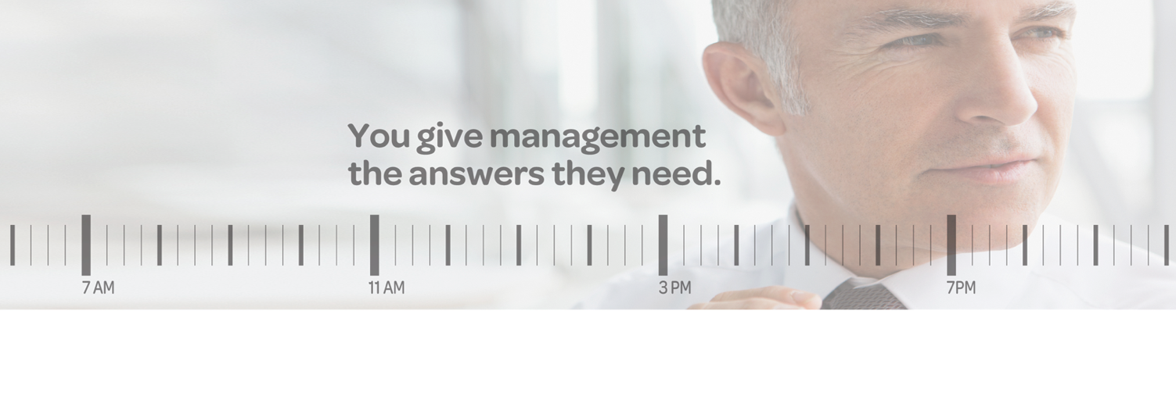
A Day In The Life…
SCHEDULED ACTIVITIES
8 AM | Status the IMS
9:30 AM | Complete the Variance Analysis
10:30 AM | Attend Risk Management Meeting
12 PM | All Hands Meeting
1:30 PM | IPT Meeting
3:30 PM | Plan out New Scope to Contract
UNPLANNED ACTIVITIES
9 AM | Major Engineering Risk Identified
10 AM | Emergency Risk Board Meeting
12:30 PM | Complete What – if scenarios to cost and schedule
5 PM | Emergency Customer Review

Slide 3


















The Support System
More
EXECUTIVE REPORTING
Time
Rework
Risk
FO
Board
CFO
Customer
VP of Programs
PROJECT
ROLES
Responsiveness
Accuracy
Analyst
Schedulers
Subs
Risk Mgr
Engineer
PM
Less
SYSTEMS
MRP
ERP
Schedule
Time
Cost
Risk

Slide 4
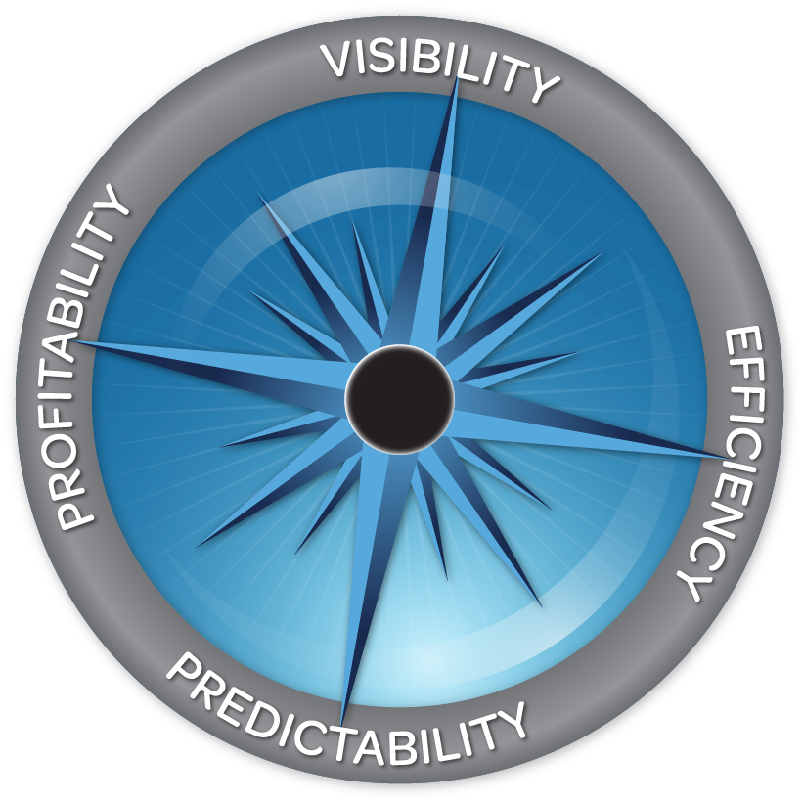

Introducing PM Compass
Delivering Integrated Program Management
PM Compass Benefits –
Your IPM Command Center
  Purpose Built
  Integrated Command Center
Process Automation and Accountability
Delivers Auditable and Accurate Data
Improves Team Collaboration
Reduces Surprises and Delays
Improves TCO

Slide 5

















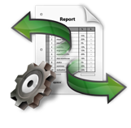
Clarity Versus Chaos....
PM COMPASS
Program Visibility and Control
Business Process Management
Systems
MRP
ERP
Schedule
Time
Cost
Risk
Project Mgmt
Costpoint
Open Plan
Time & Expense
Cobra & MPM
Active Risk

Slide 6


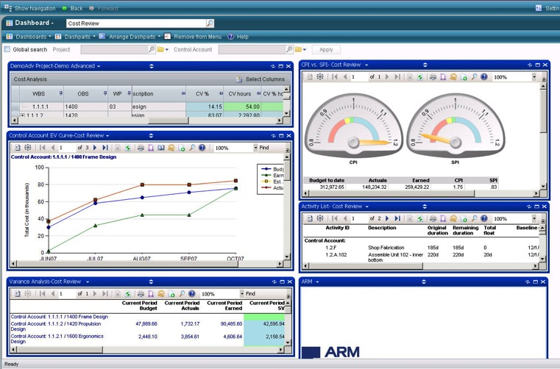
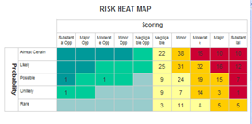
Reports and Review on Demand
From
PM Compass
From
wInsight
From Cobra or MPM
From
Risk Tool
From Costpoint

Slide 7
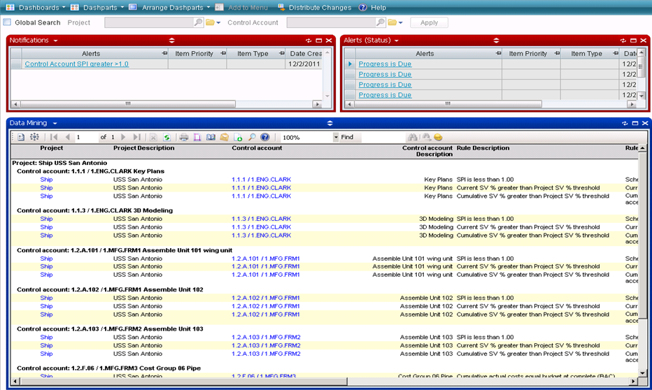
Screenshot 2
Alerts can be emailed or appear in a special window
The area affected and responsible individual
The Project
The Problem

Slide 8
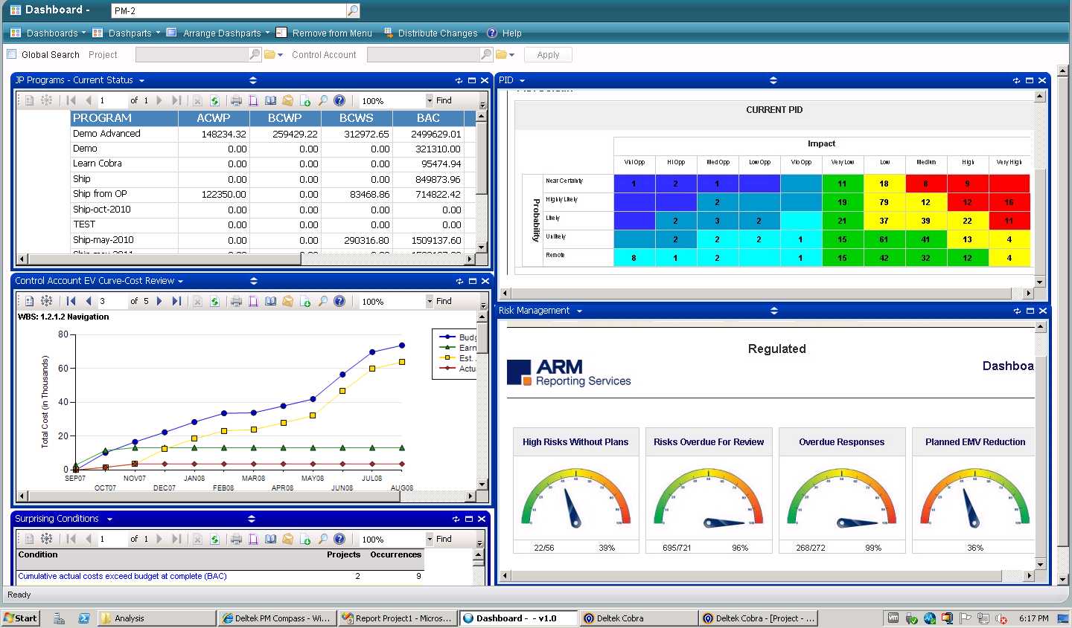
Confident Decision-making

Slide 9
Thank You!

