Slide 1
Air Force
Program Management and Acquisition Excellence
Initiatives
Fred Meyer, AF PM&AE
  04 February 2010

Slide 2
Today’s Discussion
Quick Look Schedule Assessment using Generally Accepted Accounting Principles (GASP)
Integrated Baseline Review (IBR) Process Developments

Slide 3
Using the Tools
AF PM&AE has begun to use the GASP as a framework for developing quick-look integrated master schedule assessments
  Concise
  Easily understood
  Provides pros, cons and suggested improvements
  Assigns actions for program office and industry to work collaboratively

Slide 4
GASP Essential Element
Statements
A valid schedule provides reasonable & credible information based on realistic logic, durations, & dates.
  Complete: The schedule captures the entire discrete, authorized project effort from start through completion.
  Traceable: The schedule logic is horizontally & vertically integrated with cross-references to key documents & tools.
  Transparent: The schedule provides visibility to assure it is complete, traceable, has documented assumptions, & provides full disclosure of program status & forecast.
  Statused: The schedule has accurate progress through the status date.
  Predictive: The schedule provides meaningful critical paths & accurate forecasts for remaining work through program completion.
An effective schedule is useful, helps align time-phased resources, & is built & maintained using a controlled process.
  Usable: The schedule is an indispensable tool for timely & effective management decisions & actions.
  Resourced: The schedule aligns with actual & projected resource availability.
  Controlled: The schedule is built, baselined, & maintained using a stable, repeatable, & documented process.

Slide 5
GASP Narratives
for Valid Schedules
Complete | Schedules represent authorized discrete effort for the entire contract, with essential subcontracted or other external work or milestones integrated yet distinguishable from internal work.
Traceable | Schedules reflect realistic & meaningful network logic that horizontally & vertically integrates the likely sequence for program execution. Schedules are coded to relate tasks or milestones to source or dependent documents, tools, & responsible organizations.
Transparent | Schedules provide full disclosure of program status & forecast & include documented ground rules, assumptions, & methods for building & maintaining schedules. Documentation includes steps for analyzing the critical paths, incorporating risks & opportunities, & generating schedule health & performance metrics.
Statused | Schedules reflect consistent & regular updates of completed work, interim progress, achievable remaining durations relative to the status date, & accurately maintained logic relationships.
Predictive | Schedules accurately forecast the likely completion dates & impacts to the program baseline plan through valid network logic & achievable task durations from the status date through program completion.

Slide 6
GASP Narratives
for Effective Schedules
Usable | Schedules produce meaningful metrics for timely and effective communication and tracking and improving performance, mitigating issues and risks, and capturing opportunities. Schedules are robust and functional to help stakeholders manage different levels, groupings, or areas as needed. Schedules are developed and maintained at a size, level, and complexity such that they are timely and enable effective decision-making.
Resourced | Resources align with the schedule baseline & forecast to enable stakeholders to view & assess the time-phased labor & other costs required to achieve project baseline & forecast targets. Each program is unique & uses varying techniques to load, baseline, & maintain the time-phased resources at levels that are practical & produce meaningful & accurate projections. When resource-loaded schedules are used they enable flexible updates to resource requirements as conditions change. Whether or not resource-loaded schedules are used, cost & schedule data are integrated for internal & external reporting.
Controlled | Schedules are baselined & maintained using a rigorous, stable, & repeatable process. Schedule additions, deletions, & updates conform to this process & result in valid & accurate results for sound schedule configuration control & maintenance.

Slide 7
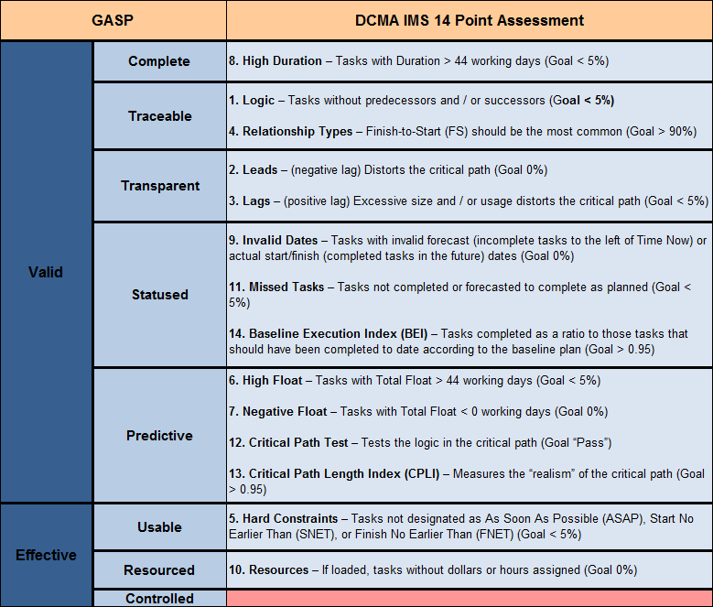
GASP / 14 Point
Assessment Comparison

Slide 8
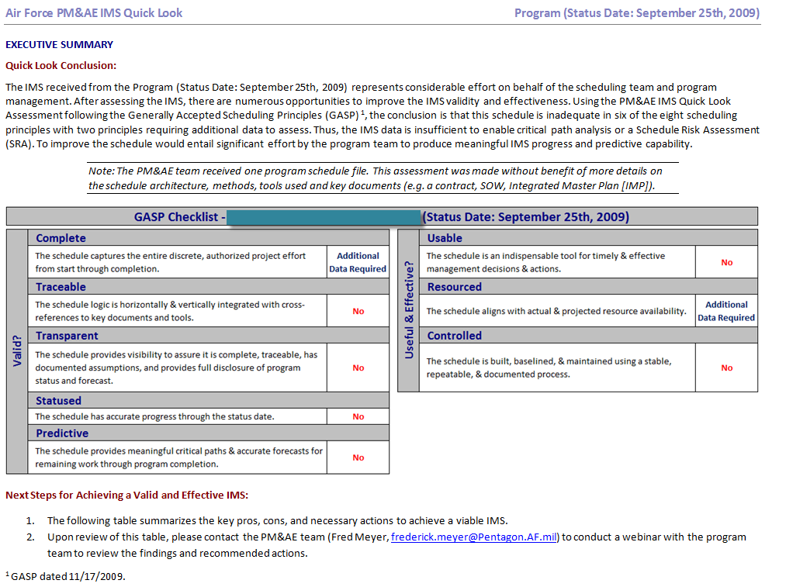
GASP Quick-Look
Schedule Assessment

Slide 9
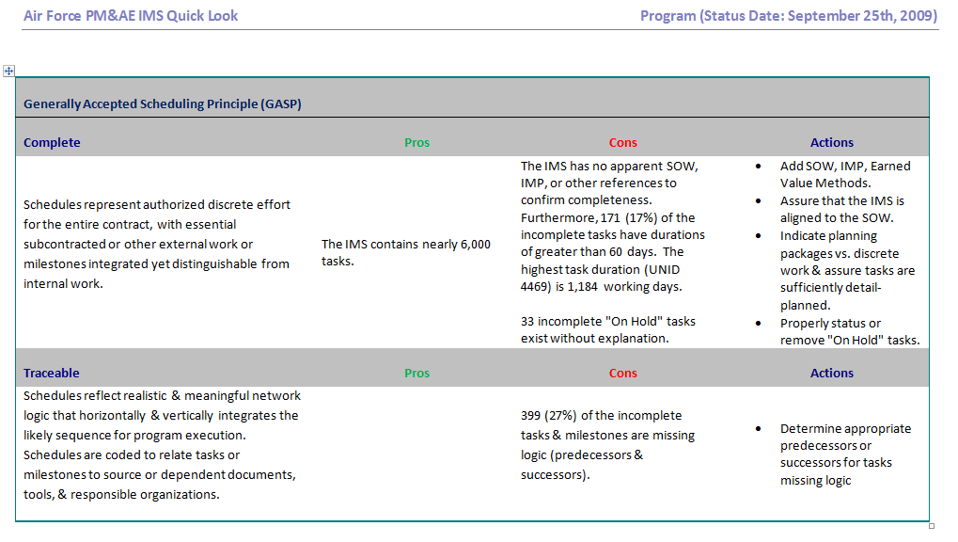
GASP Quick-Look
Schedule Assessment

Slide 10
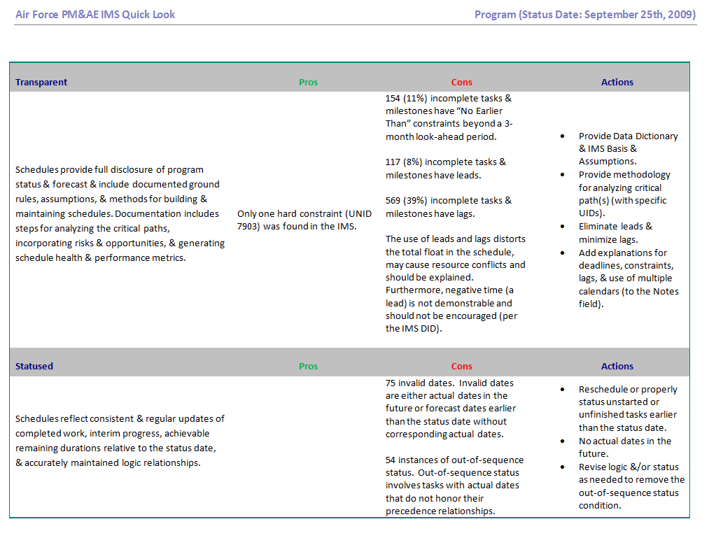
GASP Quick-Look
Schedule Assessment

Slide 11
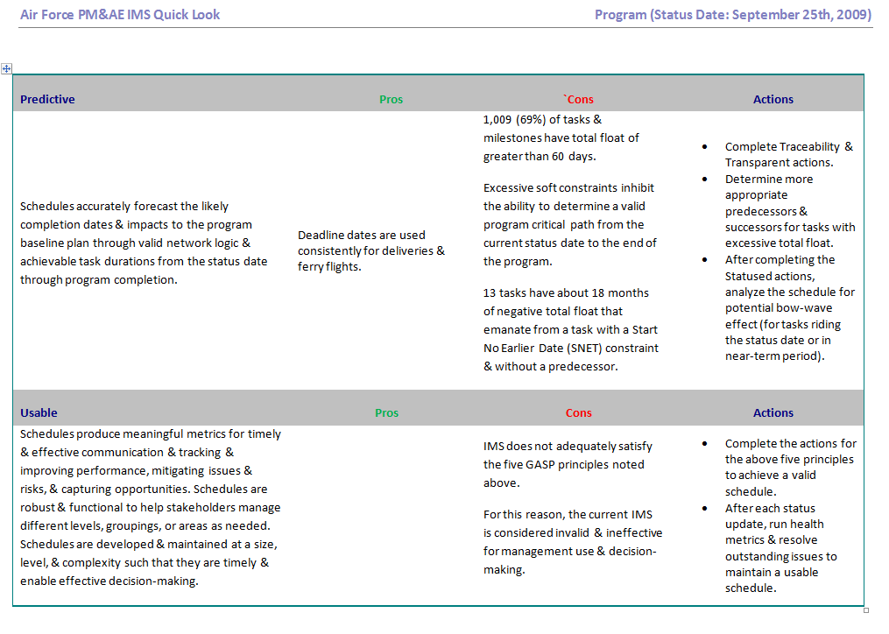
GASP Quick-Look
Schedule Assessment

Slide 12
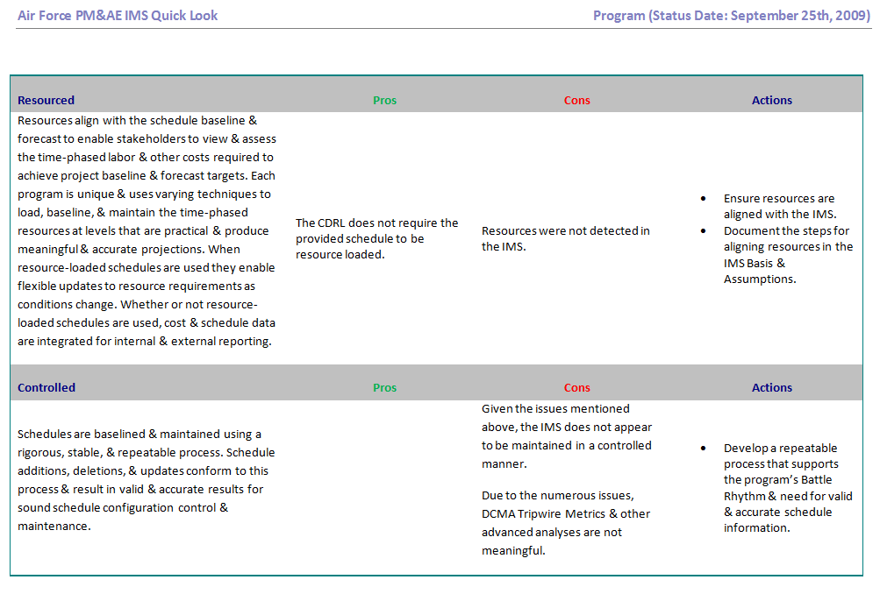
GASP Quick-Look
Schedule Assessment

Slide 13
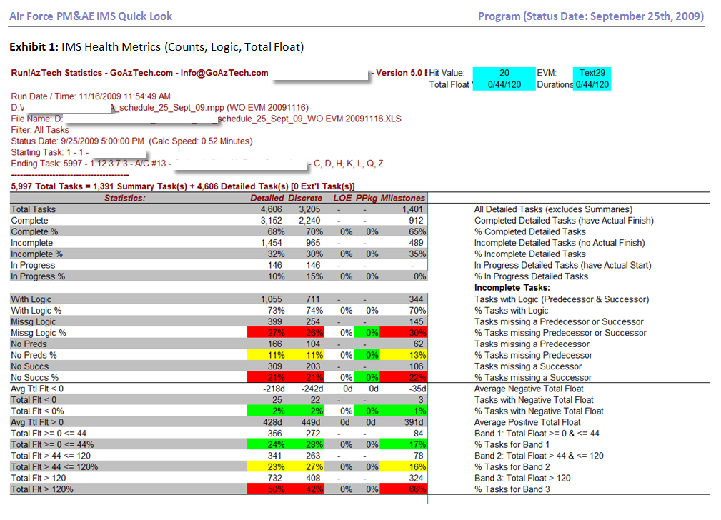
GASP Quick-Look
Schedule Assessment

Slide 14
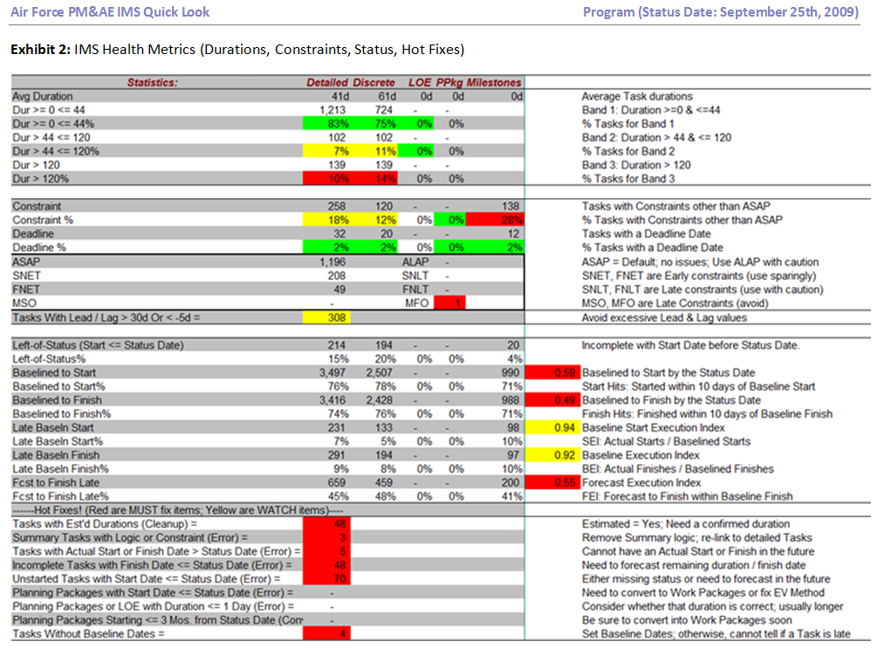
GASP Quick-Look
Schedule Assessment

Slide 15
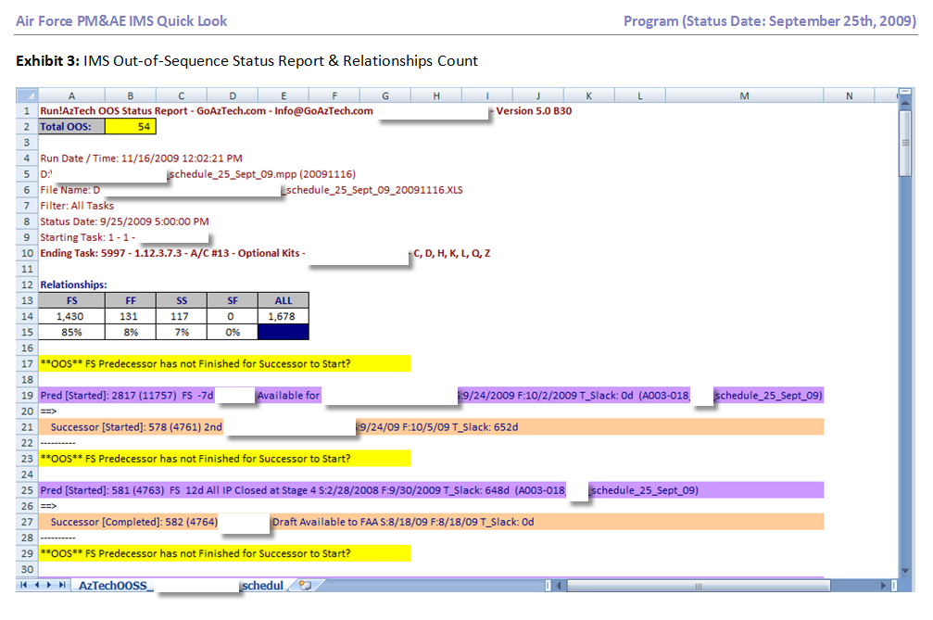
GASP Quick-Look
Schedule Assessment

Slide 16
Integrated Baseline Review Challenges
  The purpose and importance of an IBR is not understood
  Focus is not on technical issues
  Often viewed as an Earned Value Management review
  Not seen as a risk reduction activity
  “Check the box” mentality
  PMs do not understand how to evaluate contract planning risks
    Little or no focus on cost/schedule/technical integration
    Risks not quantified in dollar terms
Fixing the problem requires:
  Leadership that takes ownership and asks the right questions
  A consistent and repeatable IBR process with metrics
  Tailored training for all IBR participants
16

Slide 17
Meeting the Challenge
Develop an Air Force Integrated Baseline Review (IBR) instruction and training package
  Provides a consistent IBR methodology
  Involves all functional experts – engineering, manufacturing, cost, logistics, contracts and EVM
  Designed as a collaborative process with industry
    Workshops prior to IBR progressively train teams, increase return on IBR investment and mitigate IBR risks
    Clearly defined and consistent data call
    Process and tools includes a contractor self assessment
    Provides for a comparative quantification of cost, schedule, technical, resources and all management process risks
  Need industry input and expertise to improve process
17

Slide 18
Transforming the Process
Focus on results
To be effective the process must be
  Consistent
  Collaborative
  Scalable
  Streamlined

Slide 19
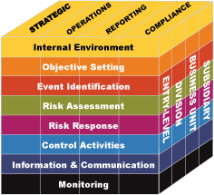
Teams
Artifacts & Weights
Integration
Program Info
Swim Lane Workshops
Technical, Schedule, Resources, Cost, Management,& Integration
Actions Library
Ongoing Actions
Data Cleanup; Issue, Risk & Opportunity Discovery
Actions
Report
IBR Results
Go
No-Go
IBR
Event

Slide 20
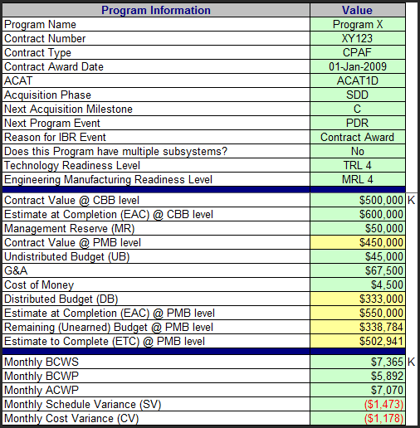
High-Level Program Information

Slide 21
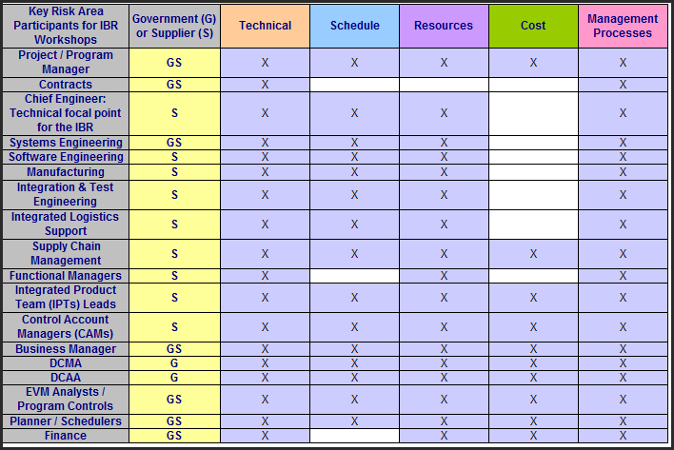
Team Attendees

Slide 22
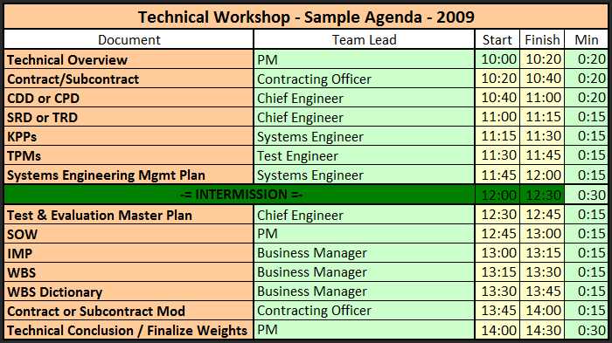
Technical Workshop Agenda

Slide 23
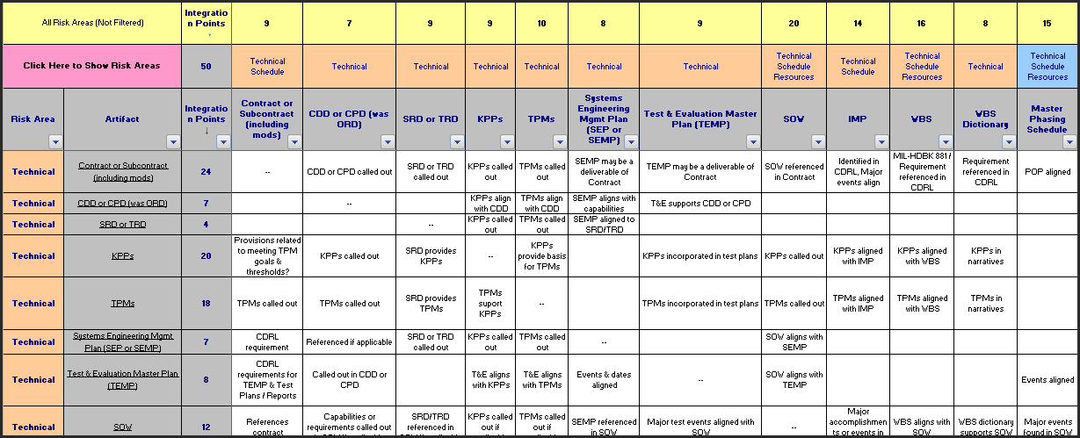
Integration Points by Artifact

Slide 24
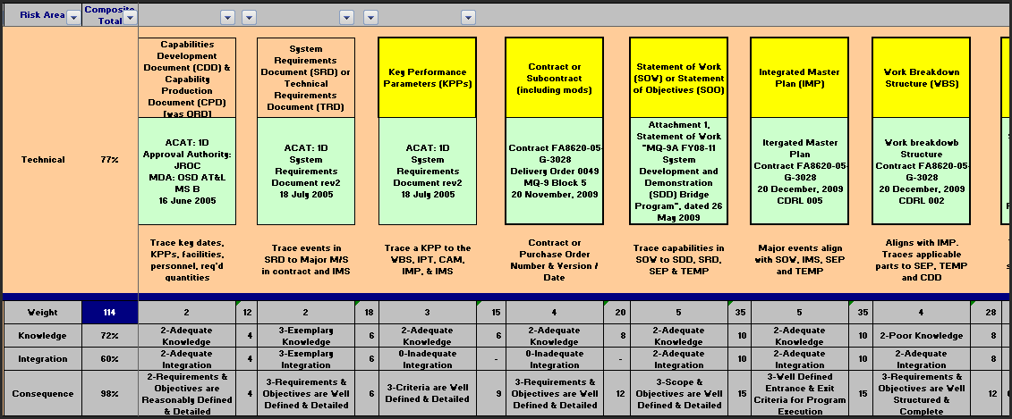
Technical Swim Lane

Slide 25
IBR Go / No Go
Artifacts (Data Call) Readiness
Points Earned | Points earned by providing adequately formatted artifacts |  | 64
Points Possible | Maximum points possible given applicable artifacts (Up to 3 Points for each Required Artifact) |  | 117
Readiness Score | Quality & Amount of Required IBR Data (% of All Applicable Artifacts) |  | 55%
Essential | % of adequately formatted Essential artifacts received | 58% | High IBR Risk
Important | % of adequately formatted Important artifacts received | 50%
Supplemental | % of adequately formatted Supplemental artifacts received | 17%
Essential artifacts like the SOW, WBS, IMP drive the basic Go / No-Go decision for conducting an IBR.
Important artifacts like a Master Phasing Schedule or supplier-provided IMS Health Metrics drive a GREEN Go decision.
Having all of the above PLUS Supplemental artifacts like resource “sand” charts result in a BLUE Go decision.

Slide 26
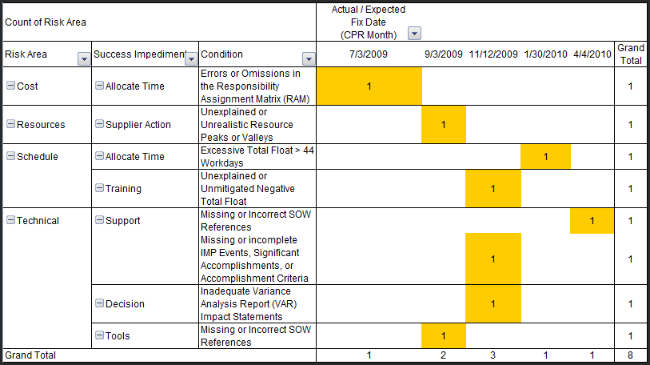
Actions Report

Slide 27
Benefits of Air Force IBR Process
IBR Panic → IBR Ready → IBR Results
Workshops are critical to IBR process success
    Technical assures we understand requirements and scope
    Schedule offers opportunities to improve the IMS
    Resources identifies and aligns staffing, vendors and facilities with schedule and cost
    Cost determines if budget targets are achievable
    Management processes assures baseline and management risk are working
IBR yields meaningful results by helping to identify and mitigate risks along the timeline that ends with the IBR event and closeout
Minimizes surprises & need for additional oversight

Slide 28
Meeting the Challenge
  The Air Force, through PM&AE, will be leading the development a DoD IBR Guide to support OSD(A&T) in implementing the recommendations of the Defense Support Team on Earned Value Management
    Detailed guidance
      “How to” vice “What is”
      Focus on technical
    Risk-based methodology
    Standardize approach, outcome measures and after review reporting formats
    Leverage ongoing PM&AE internal IBR instruction
    Use the best practices from existing Army, Navy and Intelligence Community guidance and instructions
28

